Slide 1

REAL-TIME NAVIGATION SYSTEM
FOR VISUALLY IMPAIRED PEOPLE
Project ID - 2022 - 277
SMART NAVIGATION
01

Slide 2
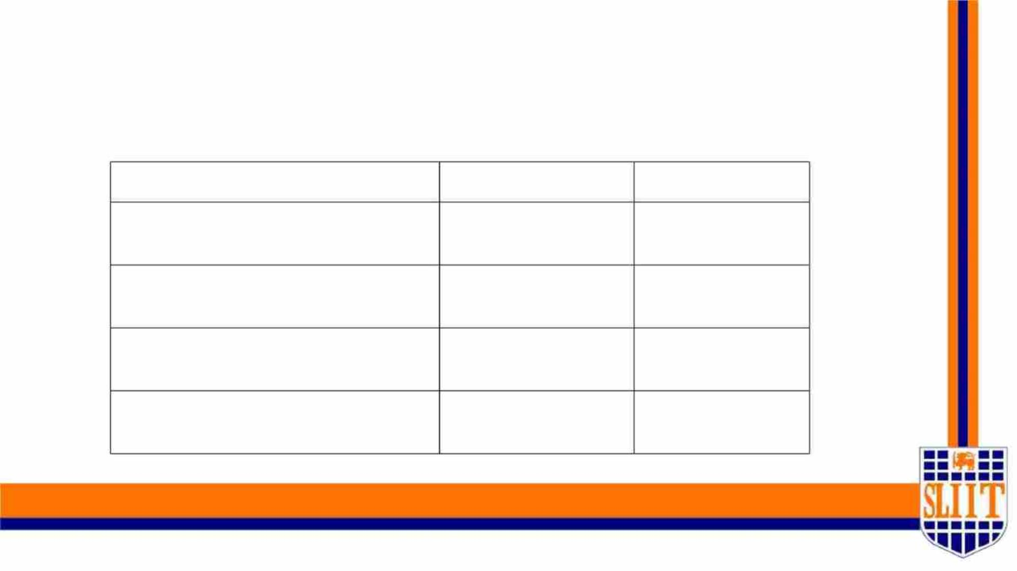
Project Supervisor - Ms. Sanjeevi Chandrasiri
Members
Student Name
Student ID
Specialization
Jathusanan.E
IT 19049878
SE
W.R.J.M.Weragoda
Madushan.W.A
IT 19008424
IT 19042152
IT 19109190
SE
SE
SE
S.R.D.Sudaraka Keshara
SMART NAVIGATION
02

Slide 3

Introduction to the
Project
SMART NAVIGATION
03

Slide 4

Overall Project Description
Ø We are implementing a system which can be used as a guide for those who are
visually handicapped.
Ø Through our application for visually impaired people, we are attempting to
improve self-sufficiency.
Ø The key features that we intend to implement through our application are walk
lane detection, road sign detection with APS system, surface and pothole
detection with obstacle detection, and relative face recognition.
Ø These features have been implemented with the help of image processing and
machine learning.
SMART NAVIGATION
04

Slide 5
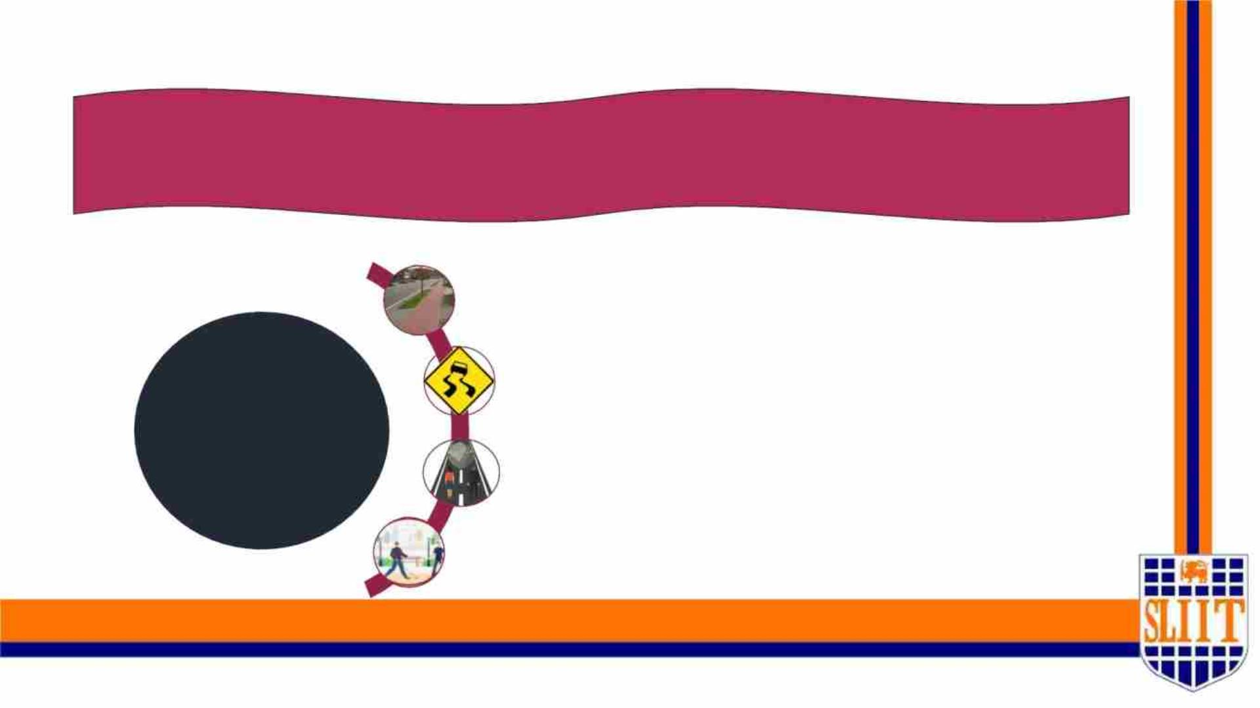
Main Research Objective
Our research recommends a smart gadget for visually impaired people to help them
navigate around the outside world.
Smart walk-lane detection & navigation in the main roads.
APS system with Road Sign Detection when
walking.
Sub
Objectives
Pothole and surface detection with obstacle detection
when walking in the surroundings.
Make Ease the detection of family, relatives and friends and
their emotions.
SMART NAVIGATION
05

Slide 6
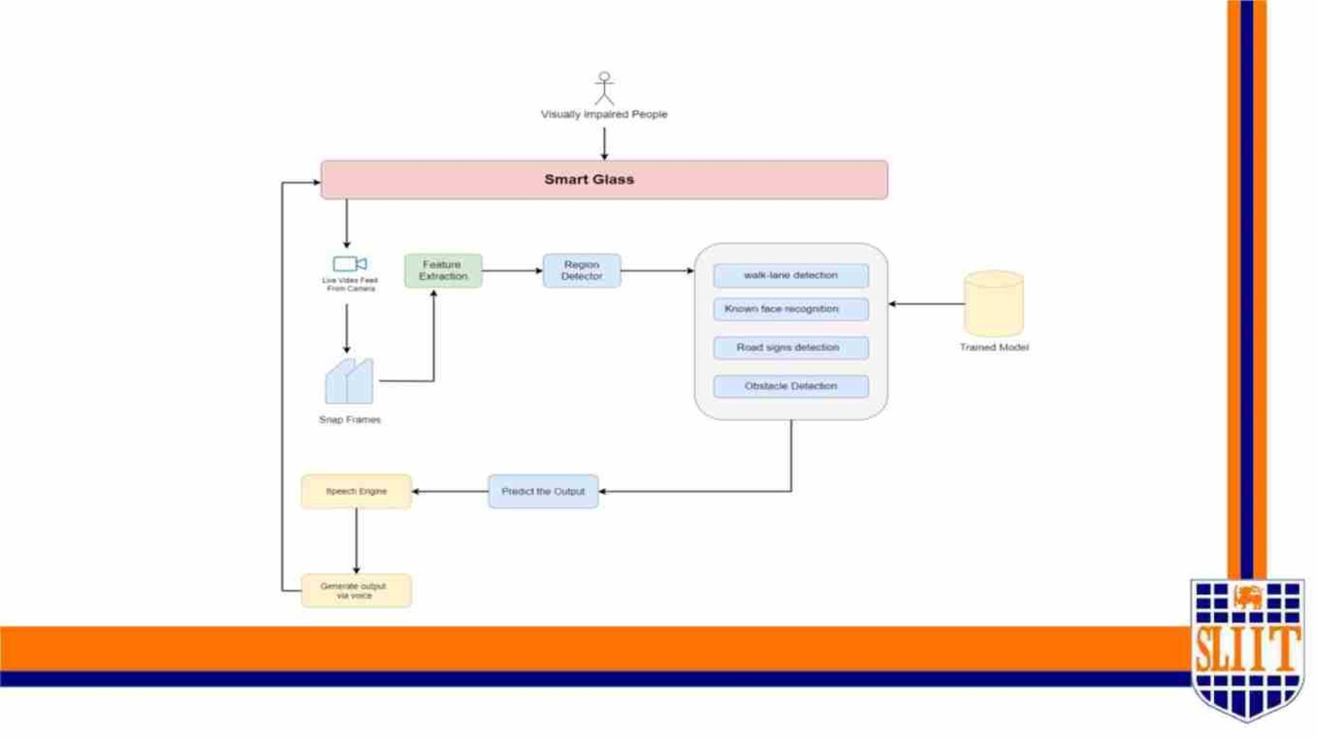
System Overview Diagram
SMART NAVIGATION
06

Slide 7
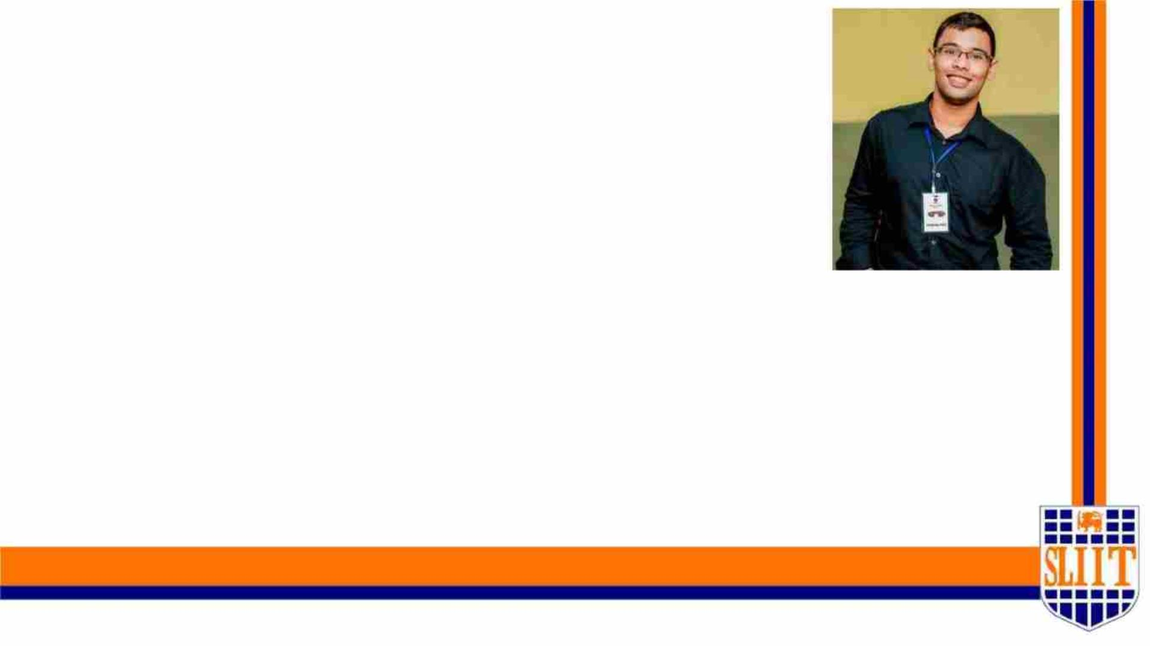
IT19109190 | KESHARA S.R.D.S
SPECIALIZATION : SE
SMART NAVIGATION TOOL FOR VISUALLY IMPAIRED PEOPLE
07
IT19109190 | KESHARA S.R.D.S | 2022-227
7

Slide 8
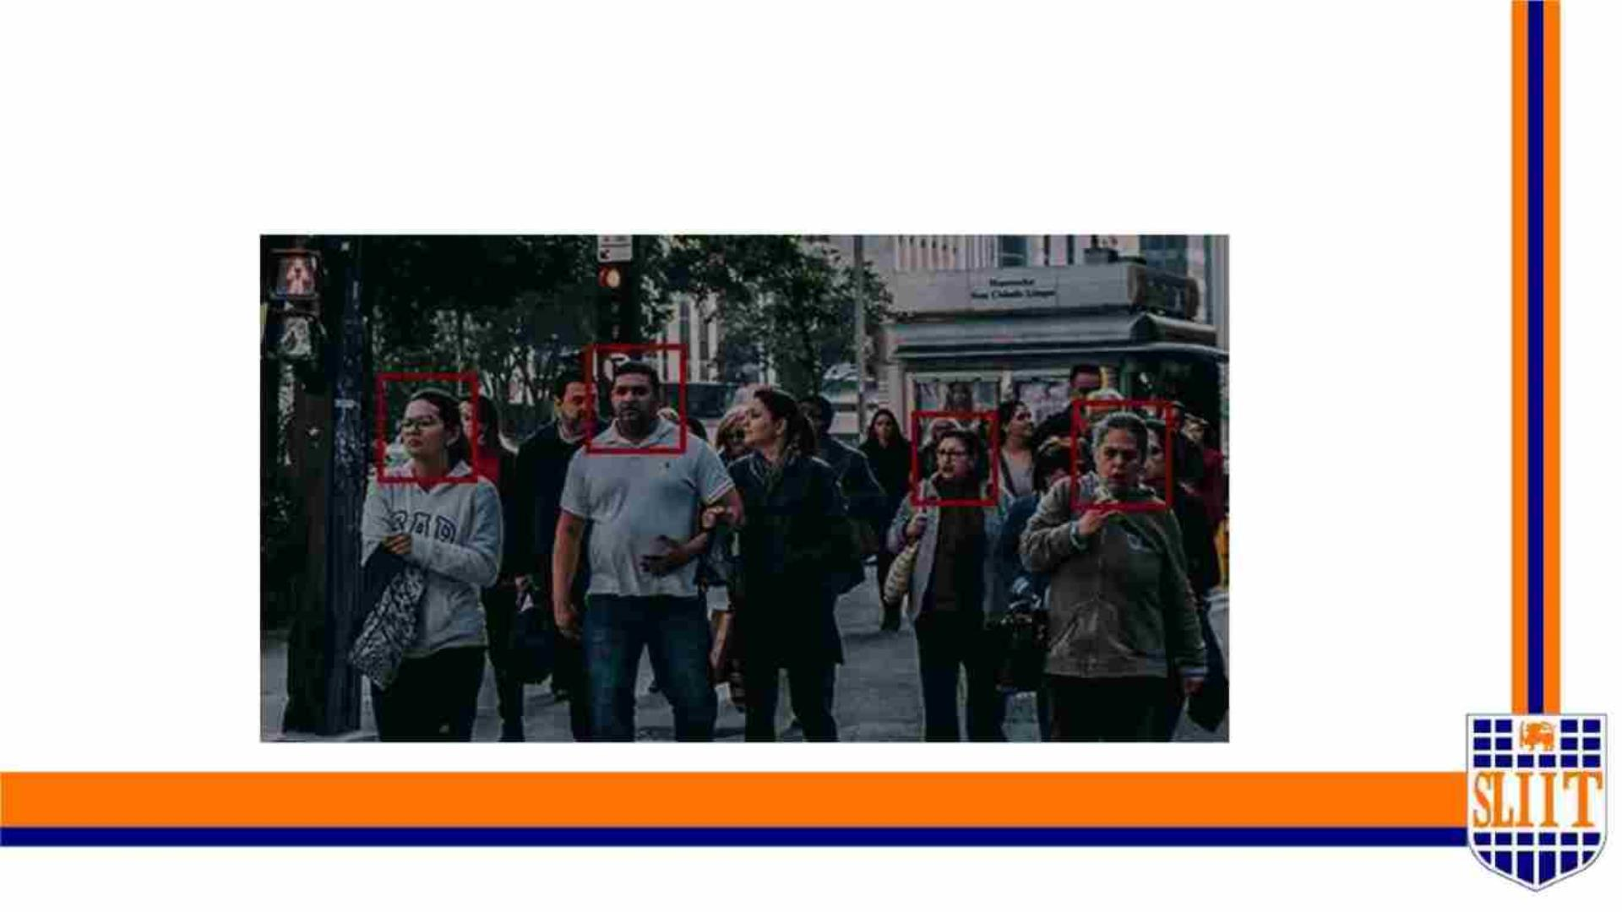
Face Recognition & Emotion Detection
of known individuals
SMART NAVIGATION TOOL FOR VISUALLY IMPAIRED PEOPLE
08
IT19109190 | KESHARA S.R.D.S | 2022-277
8

Slide 9

Research Question
When considering the solutions that have been implemented to support the
visually impaired community, the use of Electronic Travel Aids (EDA) has
become immensely popular however these devices lack several important
features when it comes to overcoming problems such as identifying a known
individual of the user in various environments. Many EDAs need to implement
this feature to overcome certain shortcomings faced by the user.
SMART NAVIGATION TOOL FOR VISUALLY IMPAIRED PEOPLE
09
IT19109190 | KESHARA S.R.D.S | 2022-277
9

Slide 10

Research Question
• Lack of ability to recognize known individuals by the user to obtain assistance in
terms of an emergency or just for a casual meet and greet.
• Users just tend to their normal walk routine using current EDAs without such a
feature.
• This causes the user to become one sided in interacting with society and tend to
cause further emotional stress for the user.
• Integrating face recognition feature with Emotion Detection function allows the
users to identify and interact freely with their social circle.
SMART NAVIGATION TOOL FOR VISUALLY IMPAIRED PEOPLE
10
IT19109190 | KESHARA S.R.D.S | 2022-277
10

Slide 11
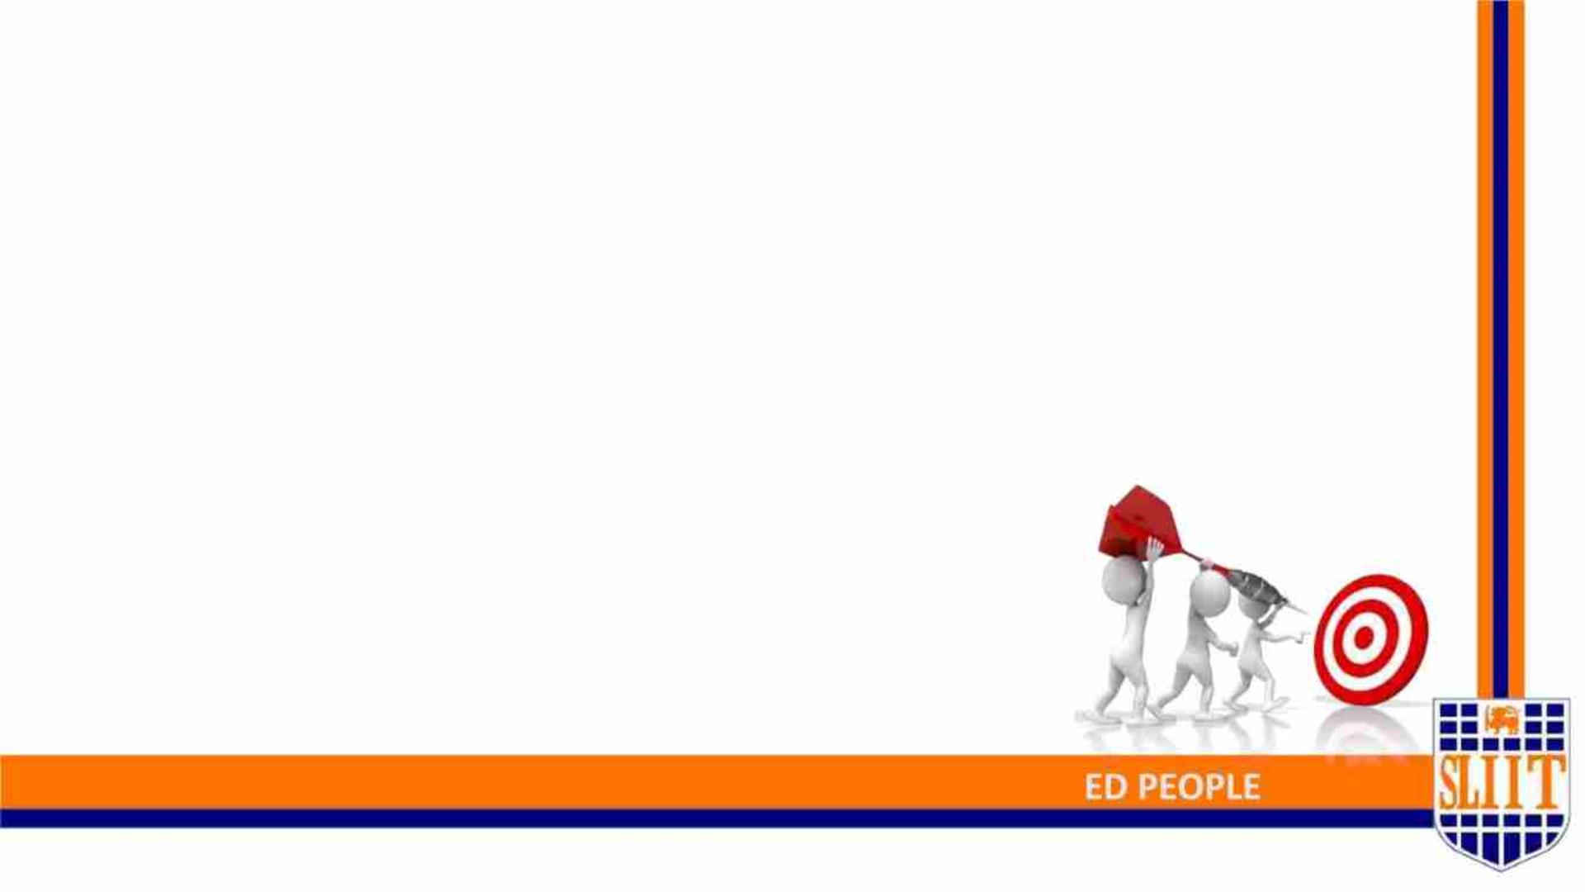
Main objective
Develop a face detection algorithm for known
individuals of the visually impaired user so that the
user can easily locate his/her loved ones and obtain
assistance when needed and pair with emotion
detection algorithm to increase social awareness while
engaging in meaningful interactions.
SMART NAVIGATION TOOL FOR VISUALLY IMPAIR
11
IT19109190 | KESHARA S.R.D.S | 2022-277
11

Slide 12
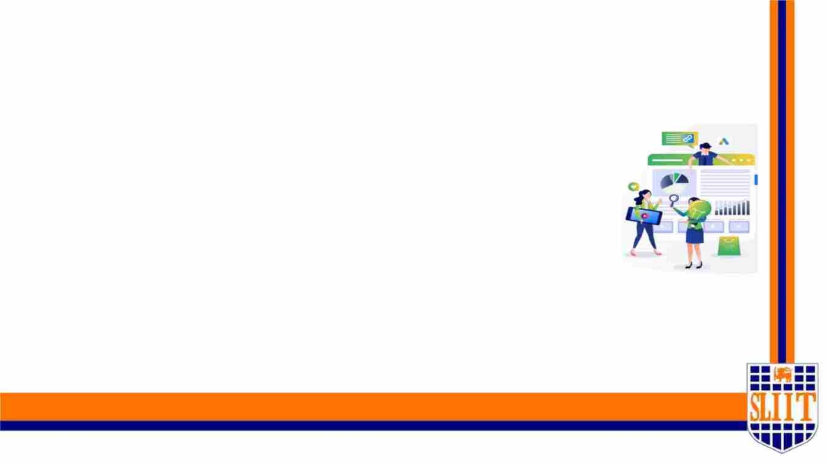
Specific objectives
vStorage of biometric data of each known individual of the user.
vAccurate face identification of known individuals in multiple
environments.
vAccurate emotion detection of identified individual.
vVoice confirmation and audio output of identified individual &
emotional aspect.
vFace recognition using partial facial features
SMART NAVIGATION TOOL FOR VISUALLY IMPAIRED PEOPLE
12
IT19109190 | KESHARA S.R.D.S | 2022-277
12

Slide 13
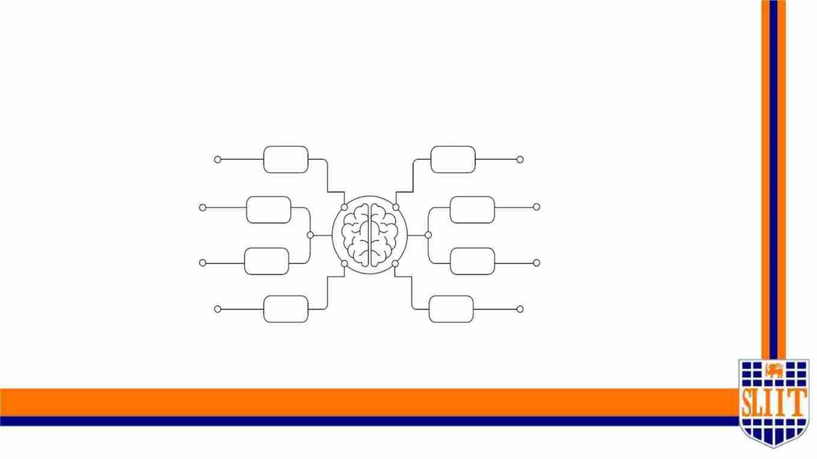
Research Methodology
SMART NAVIGATION TOOL FOR VISUALLY IMPAIRED PEOPLE
13
IT19109190 | KESHARA S.R.D.S | 2022-277
13

Slide 14
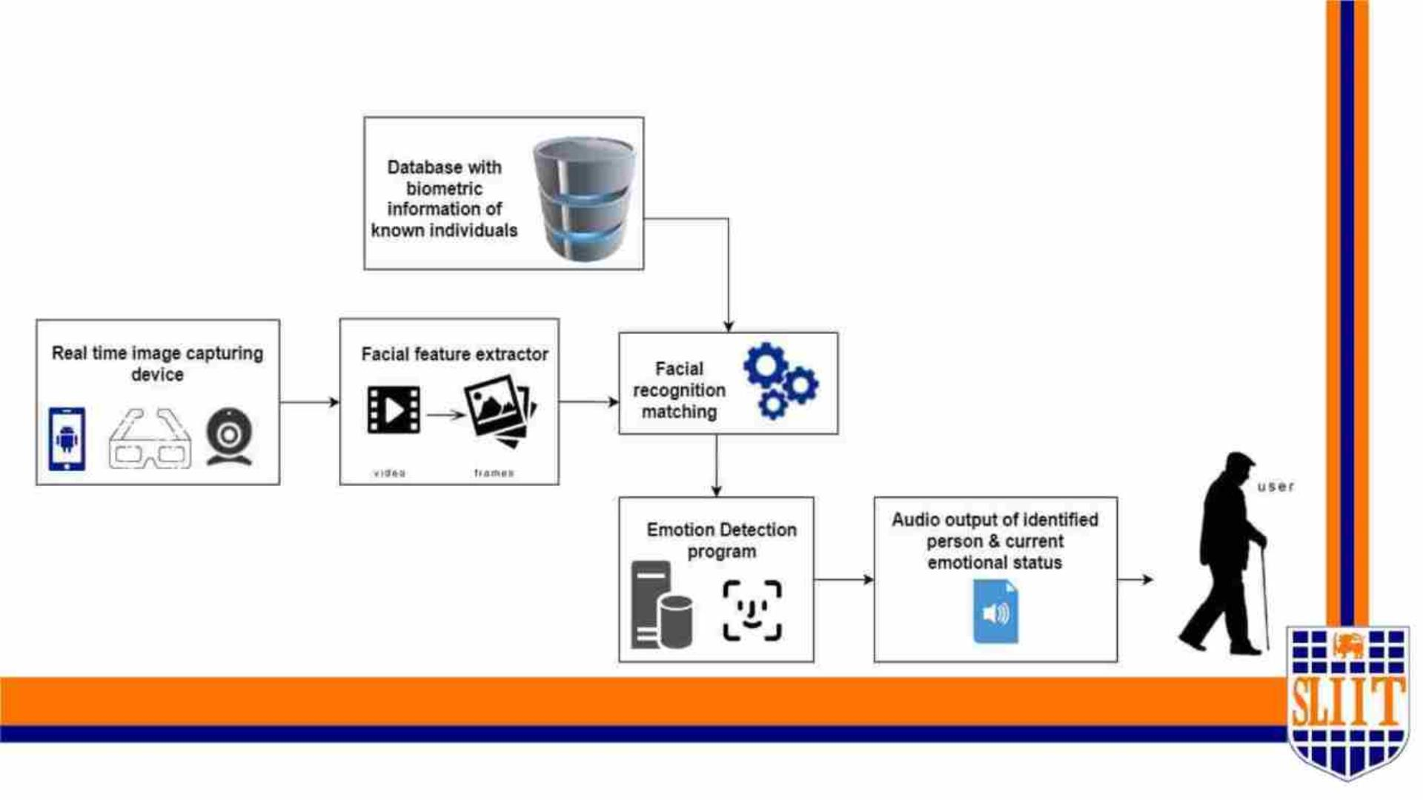
System diagram
SMART NAVIGATION TOOL FOR VISUALLY IMPAIRED PEOPLE
14
IT19109190 | KESHARA S.R.D.S | 2022-277
14

Slide 15
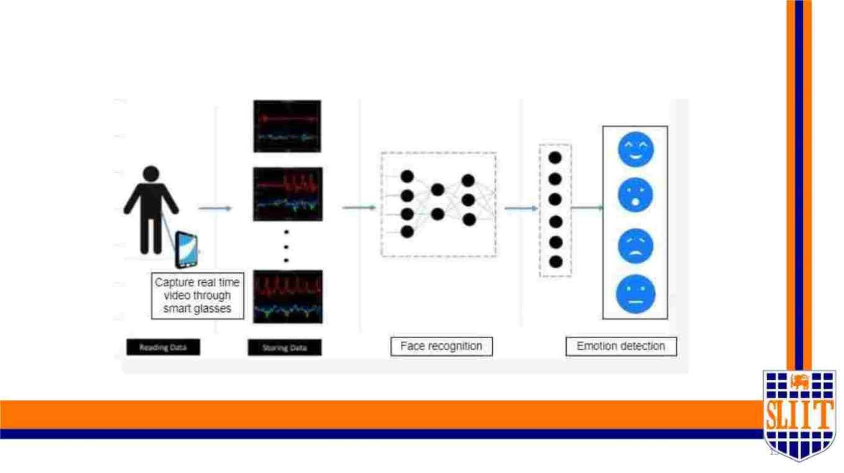
General Overview of Component
SMART NAVIGATION TOOL FOR VISUALLY IMPAIRED PEOPLE
IT19109190 | KESHARA S.R.D.S | 2022-277

Slide 16
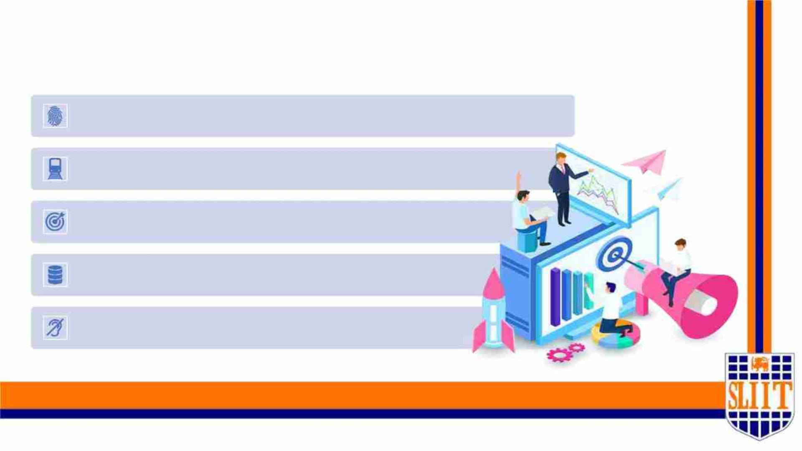
Methodology Major Phases
Data processing of biometric features of each individual known to the user.
Train and test the model.
Analysing the model accuracy.
Make decisions using output data.
Notify User via Voice Notifications.
SMART NAVIGATION TOOL FOR VISUALLY IMPAIRED PEOPLE
15
IT19109190 | KESHARA S.R.D.S | 2022-277
16

Slide 17
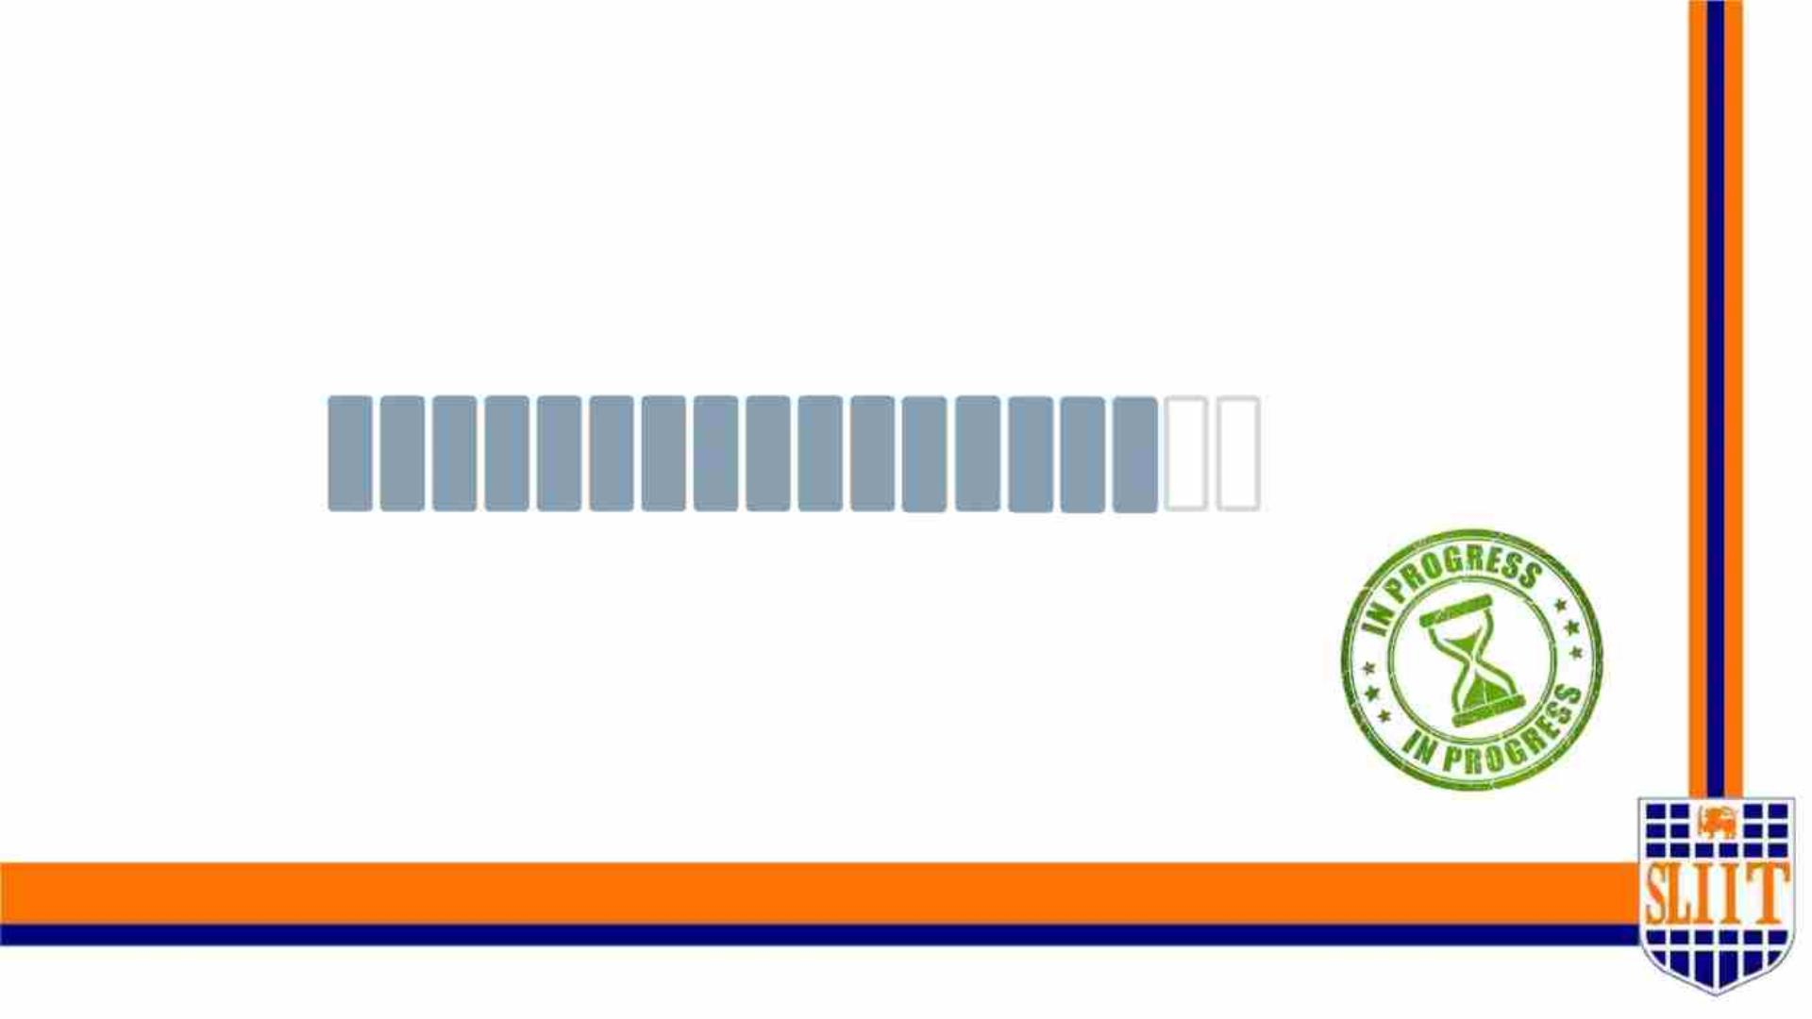
Project Completion –90%
SMART NAVIGATION TOOL FOR VISUALLY IMPAIRED PEOPLE
16
IT19109190 | KESHARA S.R.D.S | 2022-277
17

Slide 18
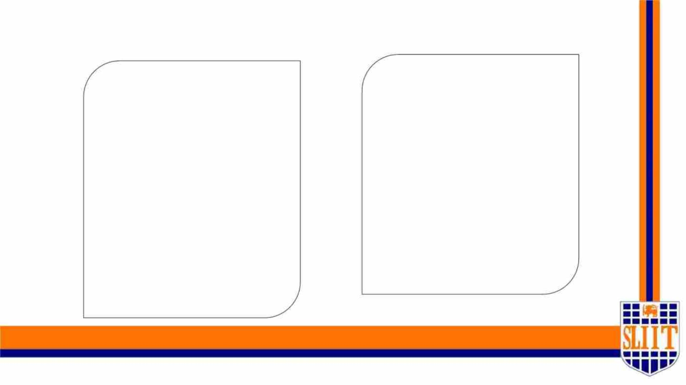
Project completion tasks
Completed work
Work to be completed
ü Dataset Collection.
o Integration with hardware
component.
ü Creating model to identify
individuals.
ü Creating model to identify
emotions.
ü Facial and emotion detection
using the Model.
ü Audio output of identified
individual and emotion
SMART NAVIGATION TOOL FOR VISUALLY IMPAIRED PEOPLE
22
IT19109190 | KESHARA S.R.D.S | 2022-277
18

Slide 19

TECHNOLOGIES USED AND TO BE USED
• Firebase
• OpenCV
• Keras
• Tensorflow
• Pycharm, Anaconda
SMART NAVIGATION TOOL FOR VISUALLY IMPAIRED PEOPLE
23
IT19109190 | KESHARA S.R.D.S | 2022-277
19

Slide 20

WORK BREAKDOWN STRUCTURE
SMART NAVIGATION TOOL FOR VISUALLY IMPAIRED PEOPLE
24
IT19109190 | KESHARA S.R.D.S | 2022-277
20

Slide 21
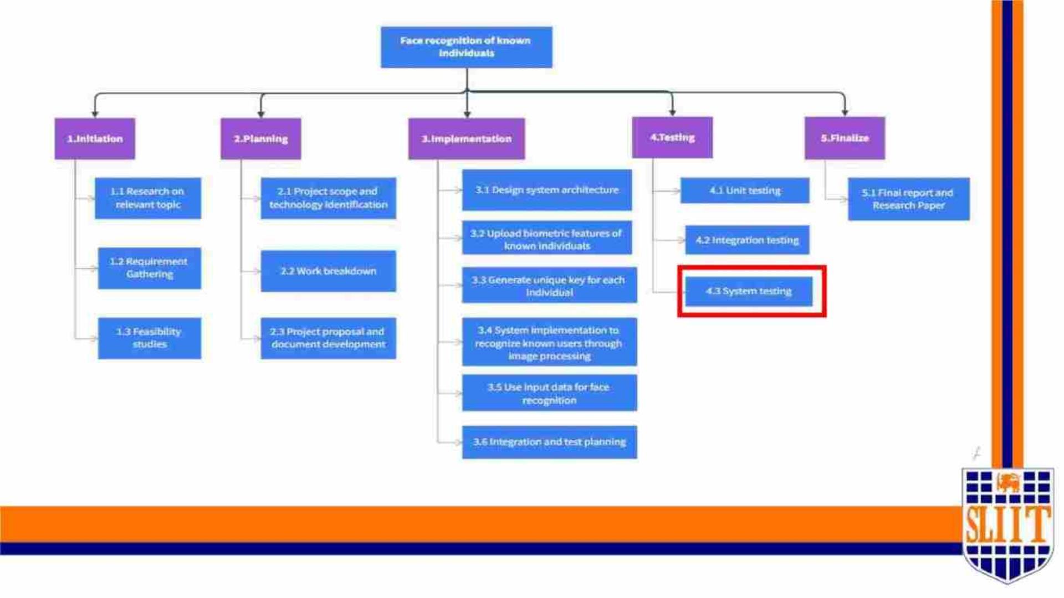
SMART NEVIGATION TOOL FOR VISUALLY IMPAIRED PEOPLE
25
IT19109190 | KESHARA S.R.D.S | 2022-277
21

Slide 22

GANTT CHART
SMART NAVIGATION TOOL FOR VISUALLY IMPAIRED PEOPLE
26
IT19109190 | KESHARA S.R.D.S | 2022-277
22

Slide 23
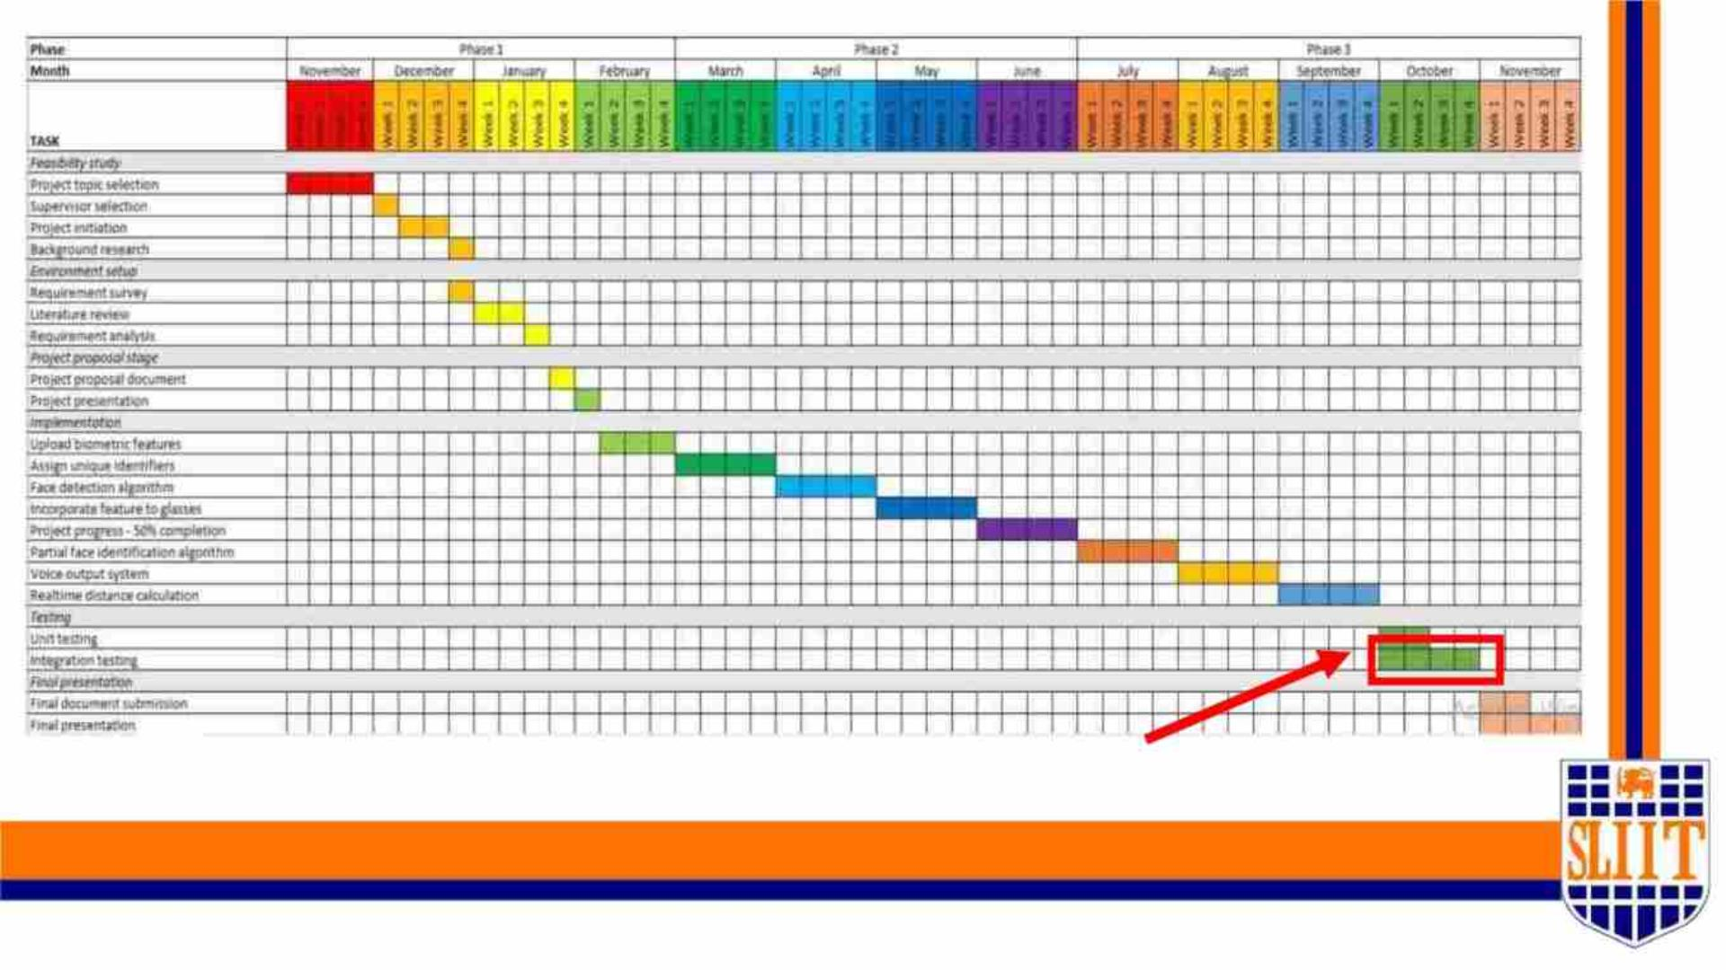
Current progress
SMART NAVIGATION TOOL FOR VISUALLY IMPAIRED PEOPLE
27
IT19109190 | KESHARA S.R.D.S | 2022-277
23

Slide 24

vReferences
1)Balakrishnan G, Sainarayanan G, Nagarajan R and Yaacob S. 2007. Wearable Real-Time
Stereo Vision for the Visually Impaired Engineering. [1]
2)Sharma, Saransh, and Samyak Jain. "A static hand gesture and face recognition system for
blind people." 2019 6th International Conference on Signal Processing and Integrated Networks
(SPIN). IEEE, 2019. [2]
3)K. M. Kramer, D. S. Hedin and D. J. Rolkosky, "Smartphone based face recognition tool for the
blind," 2010 Annual International Conference of the IEEE Engineering in Medicine and Biology,
2010. [3]
4)R. Agarwal et al., "Low cost ultrasonic smart glasses for blind," 2017 8th IEEE Annual
Information Technology, Electronics and Mobile Communication Conference (IEMCON), 2017 [4]
5)M. Awad, J. E. Haddad, E. Khneisser, T. Mahmoud, E. Yaacoub and M. Malli, "Intelligent eye: A
mobile application for assisting blind people," 2018 IEEE Middle East and North Africa
Communications Conference (MENACOMM), 2018. [5]
6)L. Albraheem et al., "Third Eye: An Eye for the Blind to Identify Objects Using Human-
Powered Technology," 2015 International Conference on Cloud Computing (ICCC), 2015. [6]
SMART NAVIGATION TOOL FOR VISUALLY IMPAIRED PEOPLE
28
IT19109190 | KESHARA S.R.D.S | 2022-277
24

Slide 25
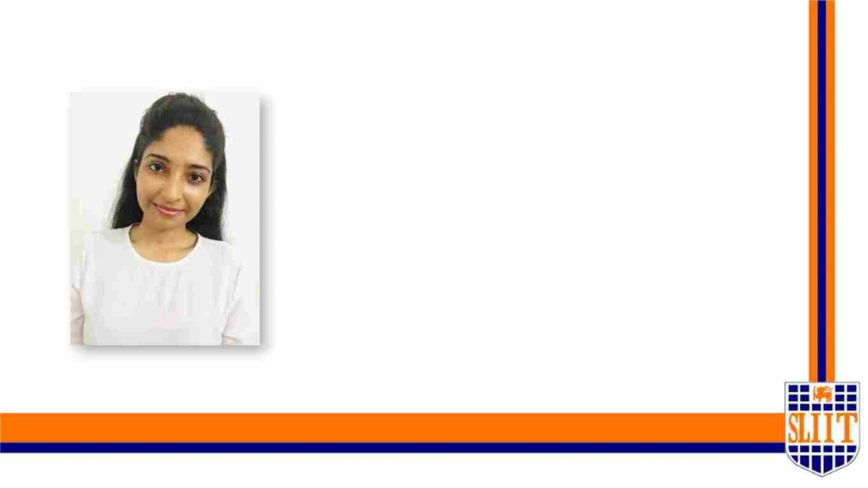
IT19008424 | W.R.J.M. WERAGODA
SPECIALIZATION : SE
SMART NAVIGATION TOOL FOR VISUALLY IMPAIRED PEOPLE
29
IT19008424 | Weragoda W.R.J.M.| 2022-227
25

Slide 26

IDENTIFYING TRAFFIC SIGNS AND
IMPLEMENTING AN ALTERNATIVE
MODEL FOR APS
SMART NAVIGATION TOOL FOR VISUALLY IMPAIRED PEOPLE
30
IT19008424 | Weragoda W.R.J.M.| 2022-227
26

Slide 27
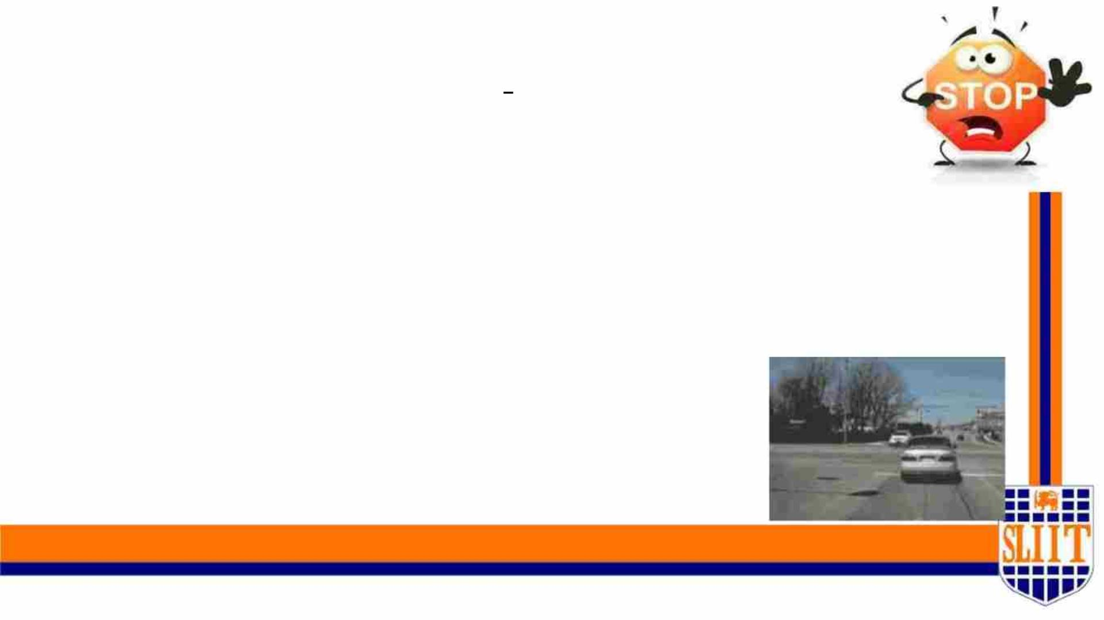
RESEARCH QUESTION
• Signage plays an important role for wayfinding
and navigation to assist blind people accessing
unfamiliar environments.
• Through this system we present a novel camera-
based approach to automatically detect and
recognize signages from surrounding
environments.
SMART NAVIGATION TOOL FOR VISUALLY IMPAIRED PEOPLE
32
IT19008424 | Weragoda W.R.J.M.| 2022-227
27

Slide 28
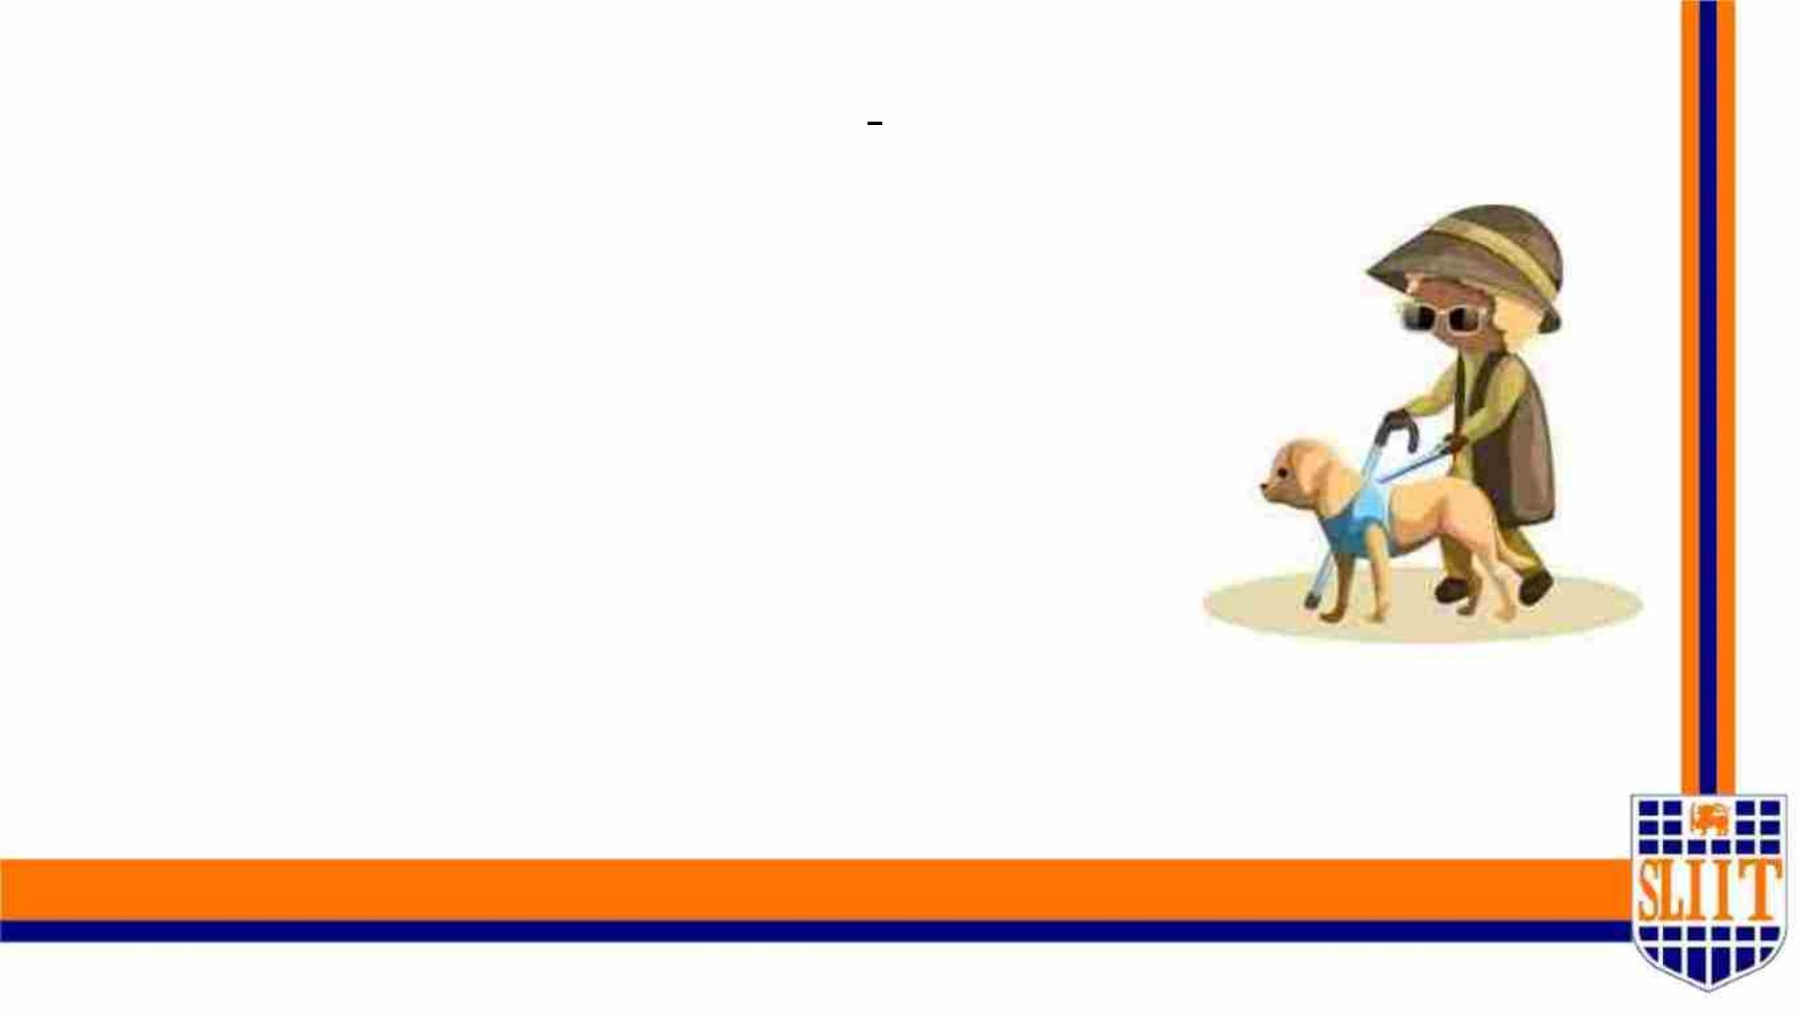
PROBLEM DEFINITION
• There are loads of existing solutions which can
be identify only the traffic signs or pedestrian
crossing.
• But, now it is clear that crossing the road is the
enormous challenge for a visually impaired and
not only because they have to deal with cars.
• Finding the edge of the street and crosswalks
and staying on course during the crossing are all
just as important tasks.
SMART NAVIGATION TOOL FOR VISUALLY IMPAIRED PEOPLE
35
IT19008424 | Weragoda W.R.J.M.| 2022-227
28

Slide 29
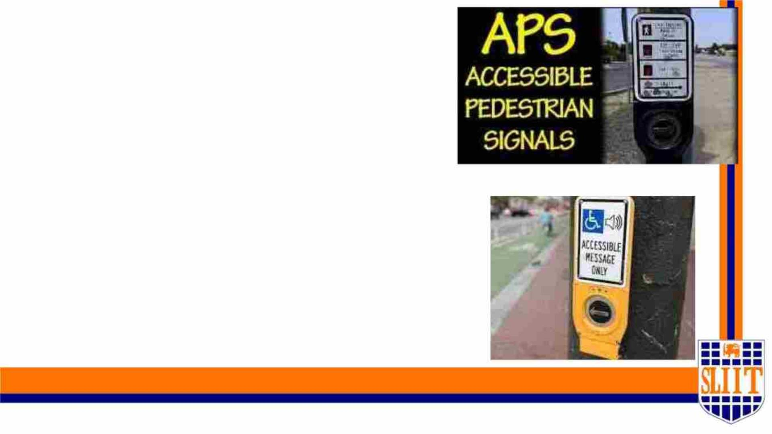
APS, Accessible Pedestrian Signals is the
existing solution for this problem.
1.This will make it easier to find a
crosswalk.
2.It will also indicate the best time to
start crossing.
3.Also it can allow a person to maintain
a straight trajectory during the entire
crossing.
SMART NAVIGATION TOOL FOR VISUALLY IMPAIRED PEOPLE
36
IT19008424 | Weragoda W.R.J.M.| 2022-227
29

Slide 30
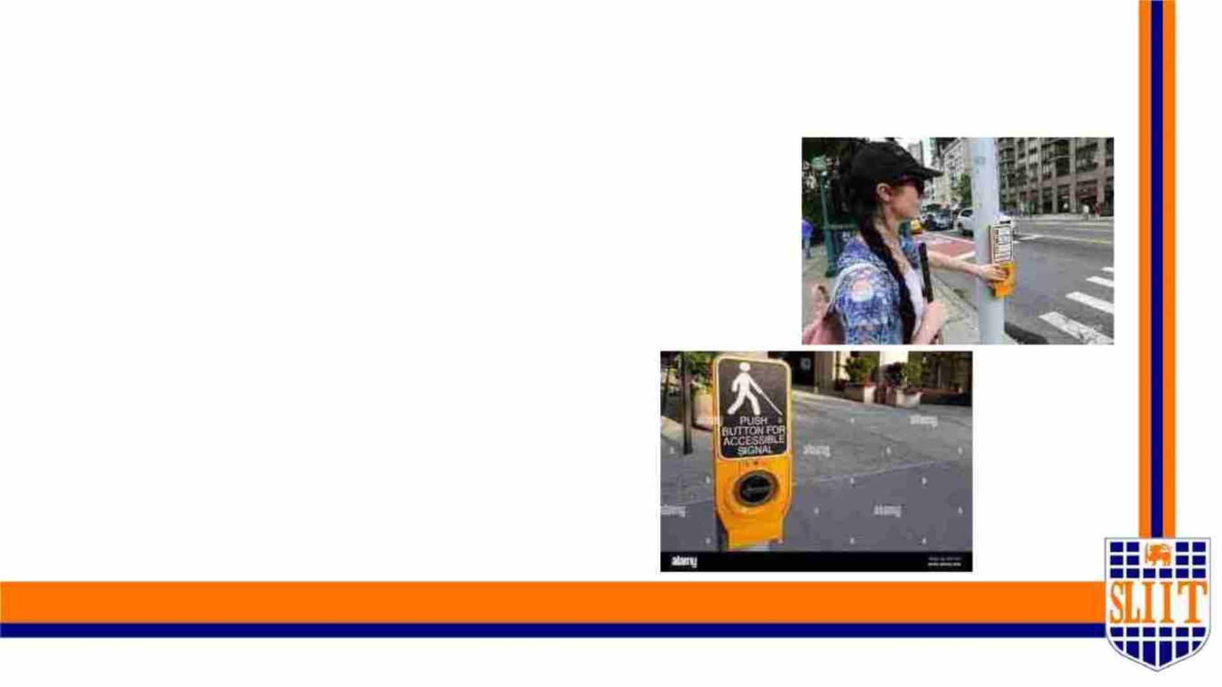
Drawbacks in the existing solution
• APS is very loud. The tones can
be loud and disruptive to some
residents especially those
residing beside traffic signals.
• There’s no need to hear all of
these sounds by other
pedestrians or drivers.
SMART NAVIGATION TOOL FOR VISUALLY IMPAIRED PEOPLE
37
IT19008424 | Weragoda W.R.J.M.| 2022-227
30

Slide 31

RESEARCH GAP
•When I working on this project I followed
hundreds of research papers.
•But none of them were able to reach all
of these requirements within a single
solution.
SMART NAVIGATION TOOL FOR VISUALLY IMPAIRED PEOPLE
34
IT19008424 | Weragoda W.R.J.M.| 2022-227
31

Slide 32
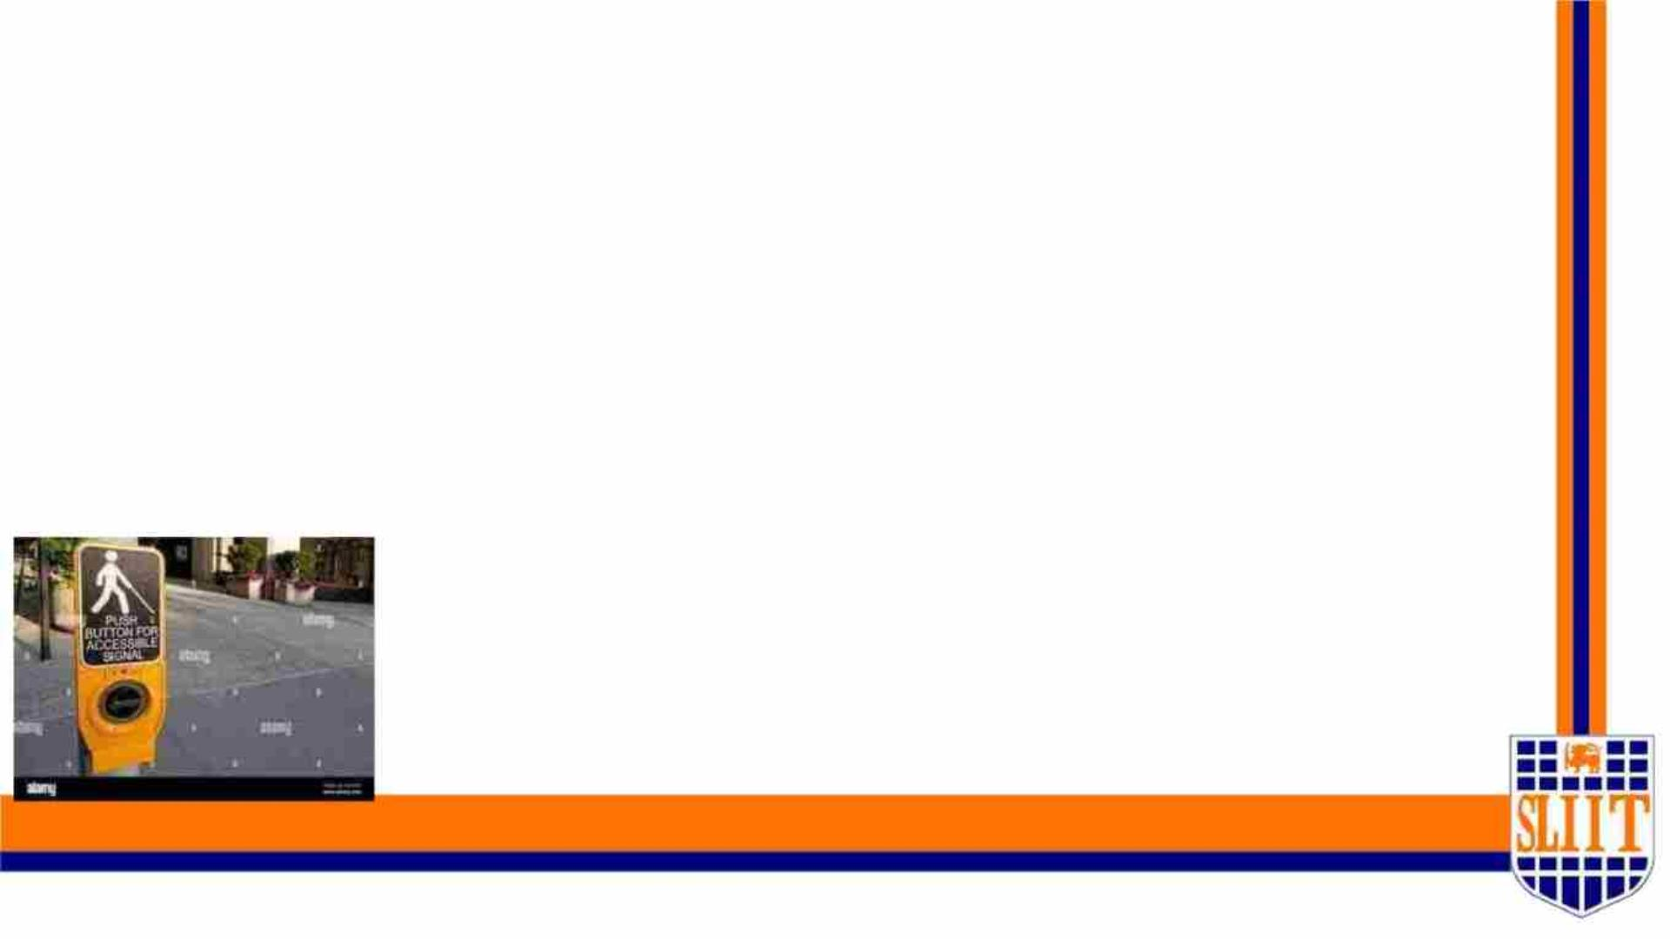
OUR SOLUTION
In order to overcome all of these challenges, we proposed a
real time system which will be an alternative system for the
existing APS system and which will automatically detect and
recognize signages from surrounding environment. It can be
used by any visually impaired person at a very low cost.
SMART NAVIGATION TOOL FOR VISUALLY IMPAIRED PEOPLE
38
IT19008424 | Weragoda W.R.J.M.| 2022-227
32

Slide 33
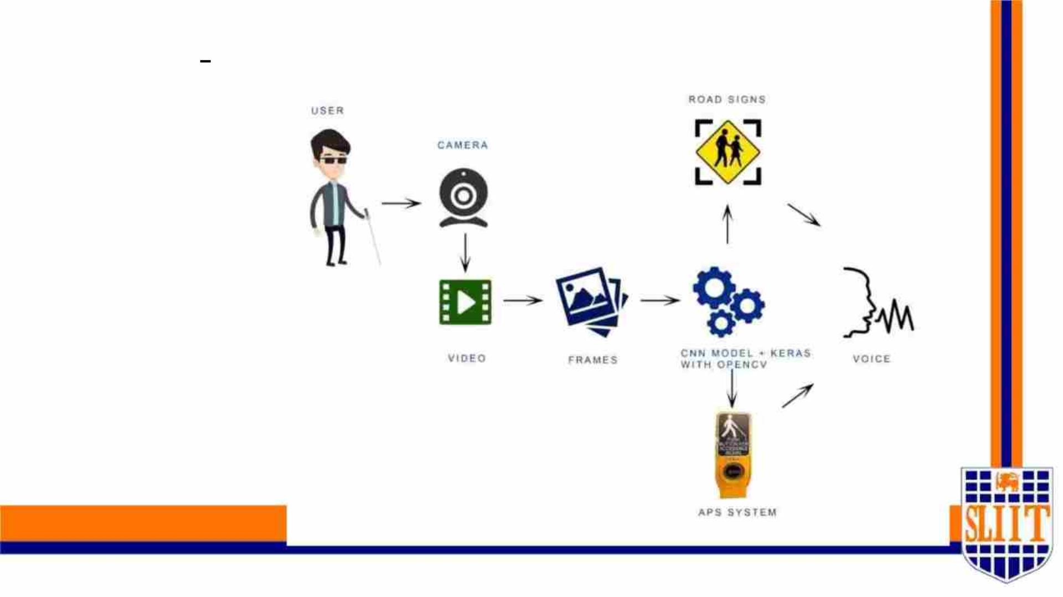
SYSTEM DIAGRAM
SMART NA
46
IT19008424 | Weragoda W.R.J.M.| 2022-227
33

Slide 34

APPLICATION OF TECHNOLOGIES
• Python
• PyCharm / Anaconda Navigator / VSCode
• matplotlib
• YOLO
• Git
• Google Colab
• Microsoft Teams
SMART NAVIGATION TOOL FOR VISUALLY IMPAIRED PEOPLE
53
IT19008424 | Weragoda W.R.J.M.| 2022-227
34

Slide 35
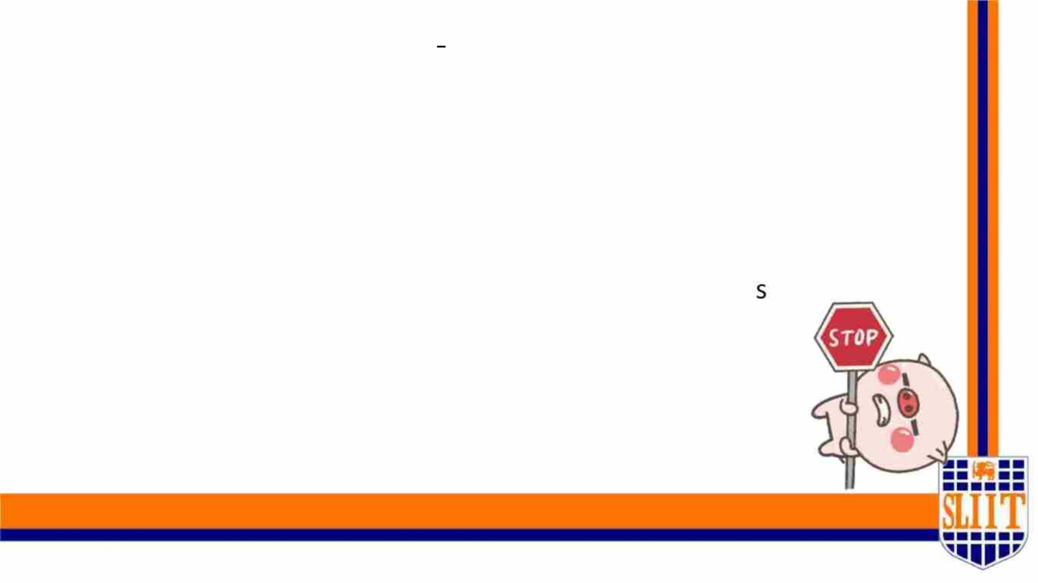
MAIN OBJECTIVE
To implement a model which can identify traffic signages,
read countdown pedestrian signals to make the decision
whether the user can cross the road safely within the
remaining time and notify the user about those warning
via voice messages.
SMART NAVIGATION TOOL FOR VISUALLY IMPAIRED PEOPLE
40
IT19008424 | Weragoda W.R.J.M.| 2022-227
35

Slide 36
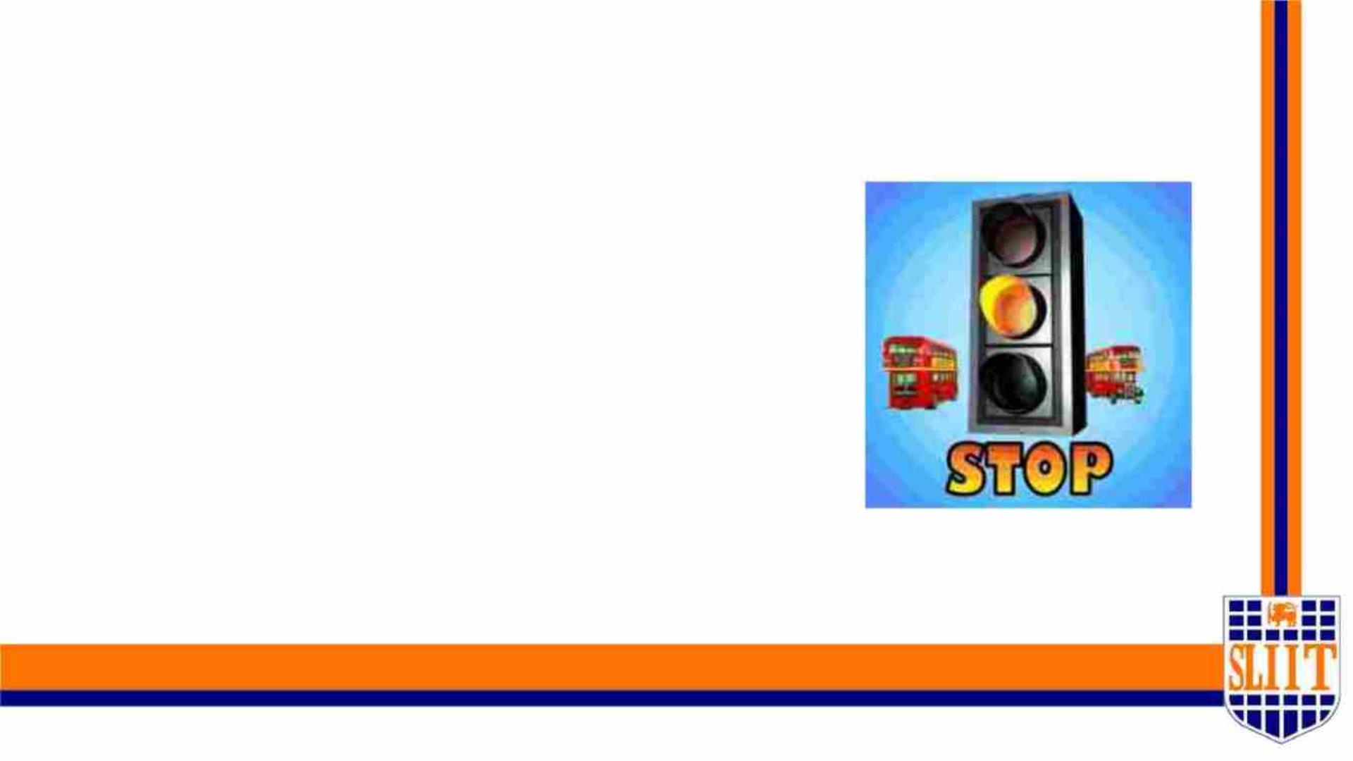
SPECIFIC OBJECTIVES
• Detect traffic signages analysing the
video stream, train a model to identify
the traffic signages and notify the user
via vocal instructions.
• Implement a model to read countdown
pedestrian signals, make the decision
whether the user can cross the road
safely within the remaining time or not,
notify the user about warnings via vocal
instructions.
SMART NAVIGATION TOOL FOR VISUALLY IMPAIRED PEOPLE
41
IT19008424 | Weragoda W.R.J.M.| 2022-227
36

Slide 37

APPLICATION OF KEY PILLARS
• We require a model which can detect and classify the signs at
real time. In this work, we explore the YOLO architecture.
• Which exhibits a real time object detection and classification
at around 45 frames per second.
• This would be highly suitable for our problem, which requires
high speed and accuracy. We have developed a YOLO based
architecture for the traffic sign detection of Robo Flow
Dataset.
SMART NAVIGATION TOOL FOR VISUALLY IMPAIRED PEOPLE
43
IT19008424 | Weragoda W.R.J.M.| 2022-227
37

Slide 38
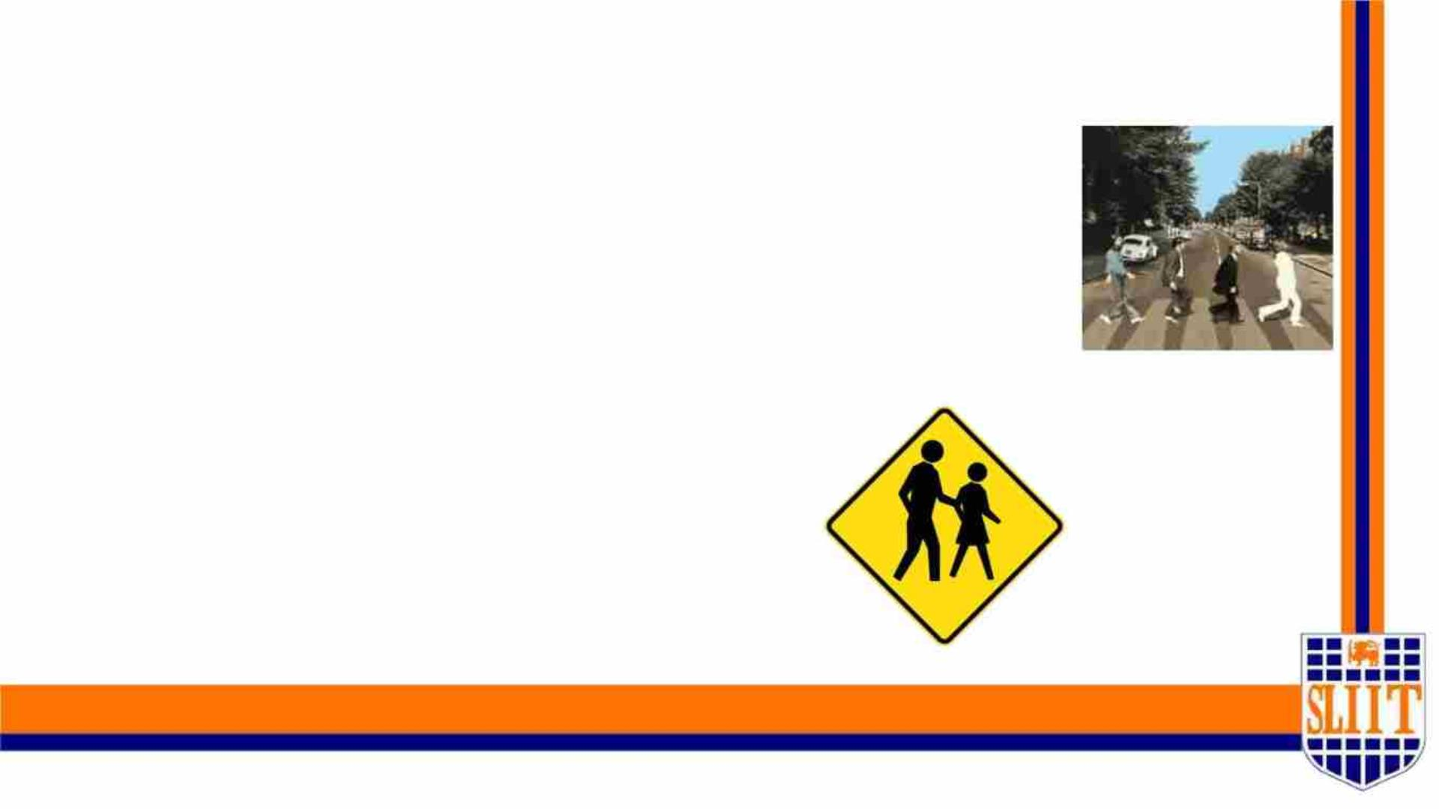
Methodology Major Phases
• Data Processing.
• Train and Test the Model.
• Modal accuracy Analysing.
• Make decisions using Output data.
• Notify User via Voice Notifications.
SMART NAVIGATION TOOL FOR VISUALLY IMPAIRED PEOPLE
44
IT19008424 | Weragoda W.R.J.M.| 2022-227
38

Slide 39
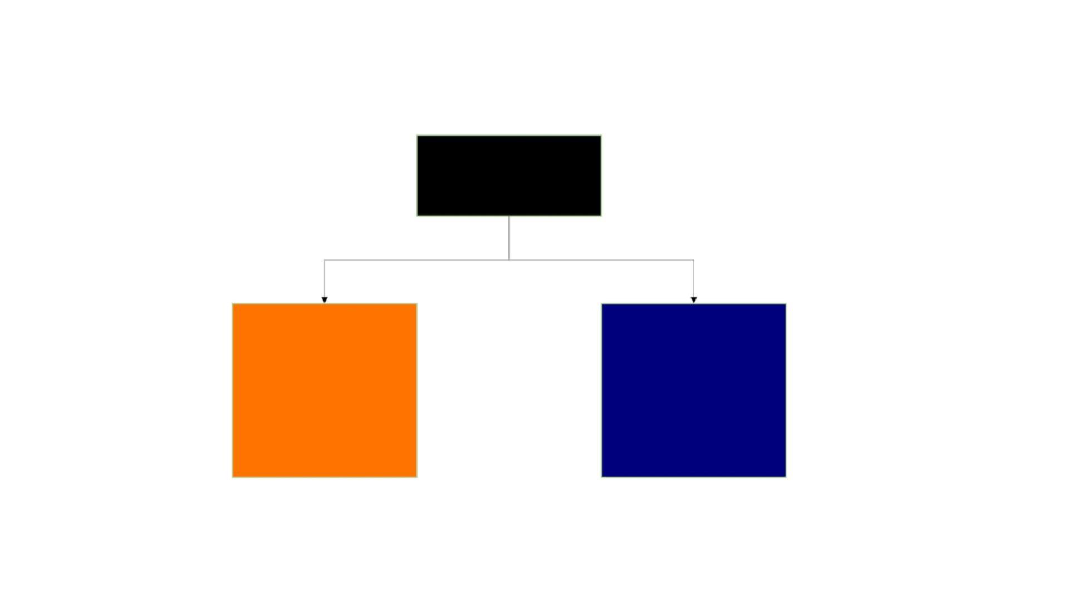
METHODOLOGY
Component
Alternative System
for APS
Traffic Sign
Detection
39

Slide 40
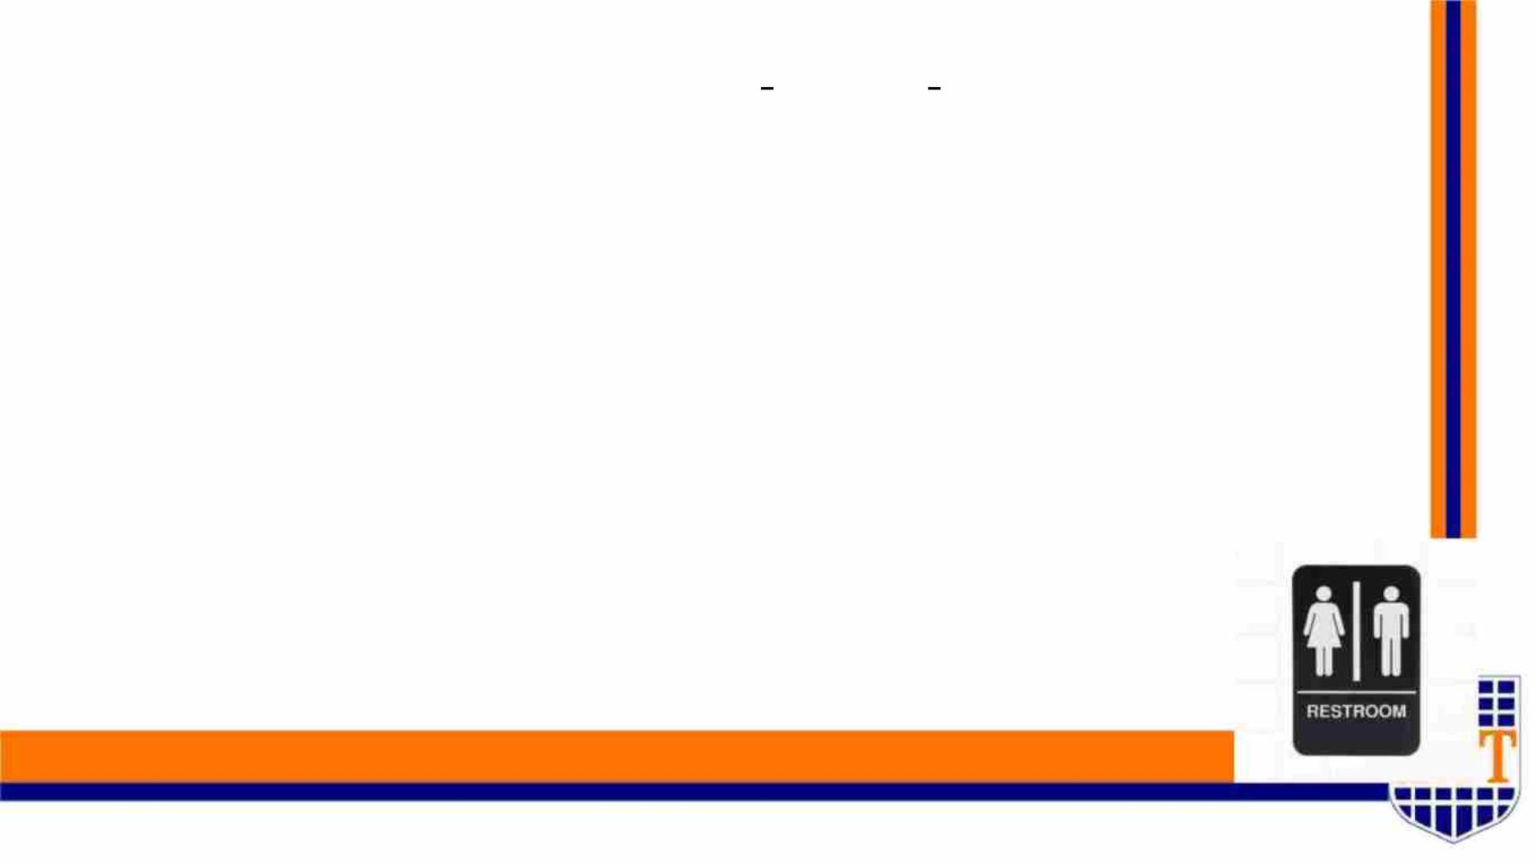
Methodology Major Phases
1. Data Processing
First we used a data set which is manually collected by us. But it
wasn’t sufficient for the implementation.
Then we used an another data set which is on Robo Flow site.
This data set contains 1257 images with 18 classes.
SMART NAVIGATION TOOL FOR VISUALLY IMPAIRED PEOPLE
44
IT19008424 | Weragoda W.R.J.M.| 2022-227
40

Slide 41
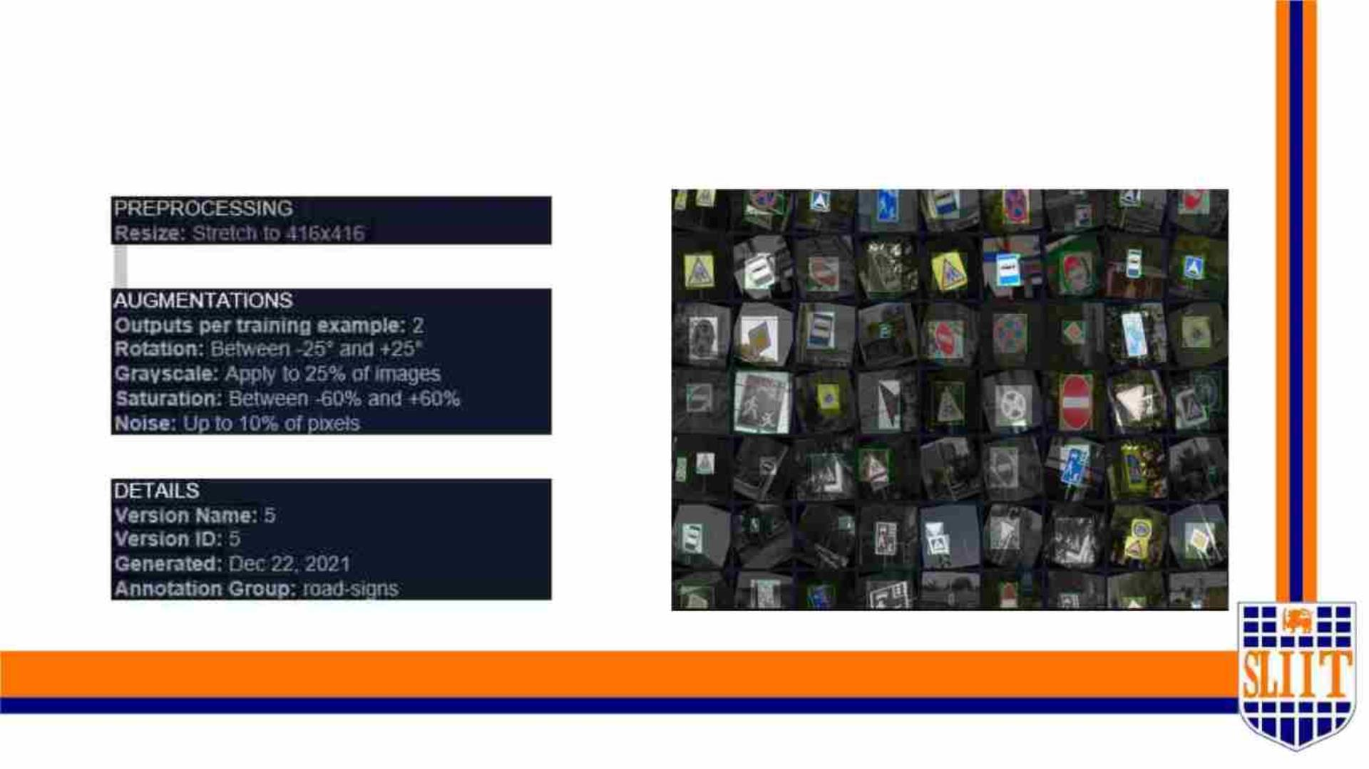
1. Data Processing - ROBO FLOW DATASET
SMART NAVIGATION TOOL FOR VISUALLY IMPAIRED PEOPLE
44
IT19008424 | Weragoda W.R.J.M.| 2022-227
41

Slide 42
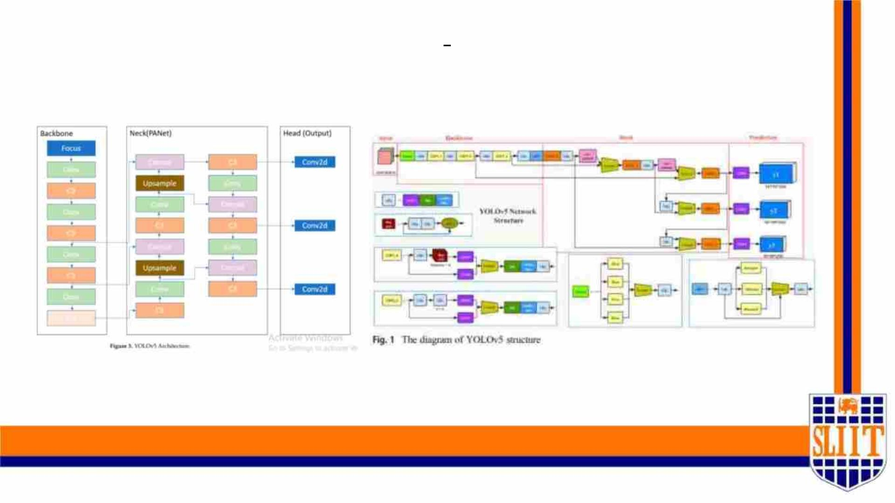
YOLO V5
SMART NAVIGATION TOOL FOR VISUALLY IMPAIRED PEOPLE
44
IT19008424 | Weragoda W.R.J.M.| 2022-227
42

Slide 43
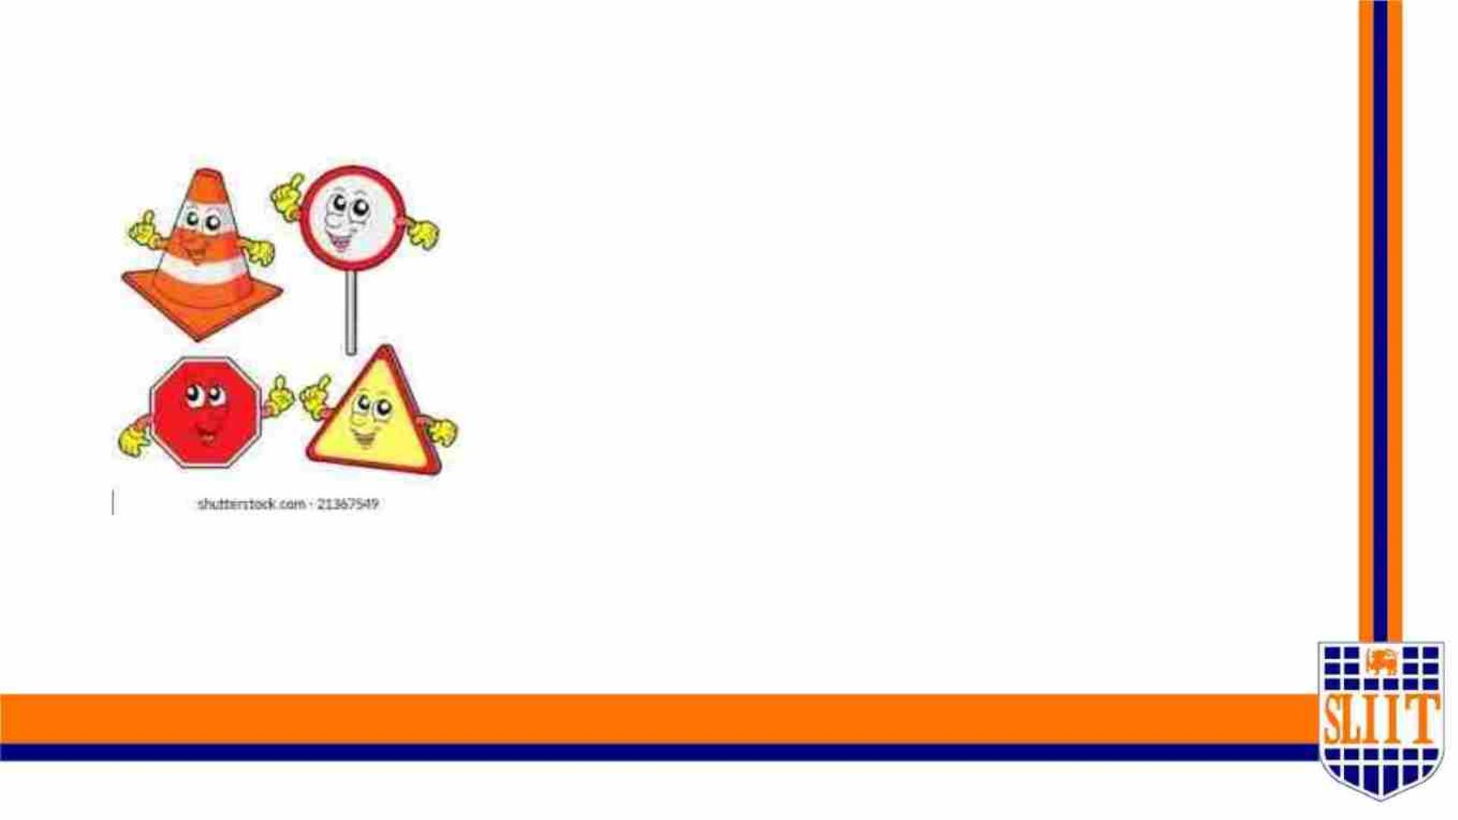
90% COMPLETION OF THE
PROJECT
SMART NAVIGATION TOOL FOR VISUALLY IMPAIRED PEOPLE
47
IT19008424 | Weragoda W.R.J.M.| 2022-227
43

Slide 44
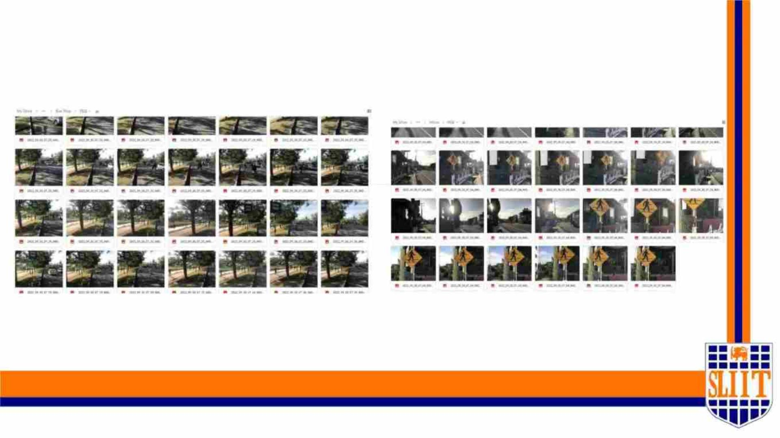
A. Data preparation
SMART NAVIGATION TOOL FOR VISUALLY IMPAIRED PEOPLE
52
IT19008424 | Weragoda W.R.J.M.| 2022-227
44

Slide 45
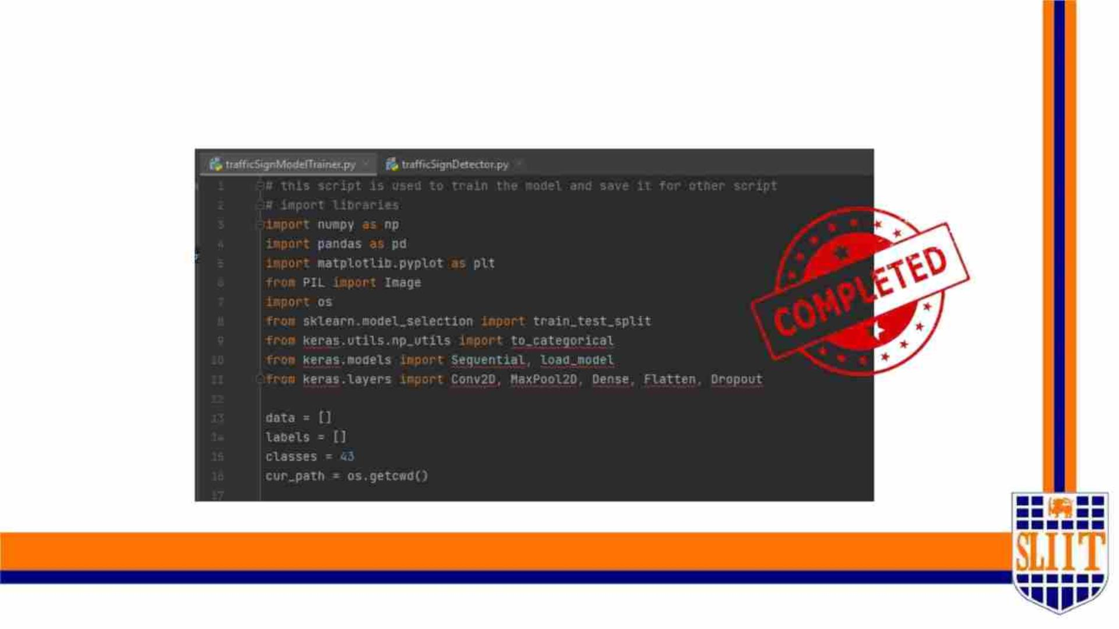
B. Import Libraries and Load Dataset
SMART NAVIGATION TOOL FOR VISUALLY IMPAIRED PEOPLE
48
IT19008424 | Weragoda W.R.J.M.| 2022-227
45

Slide 46
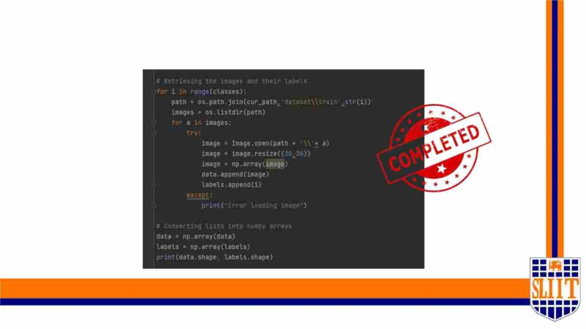
C. Training and Testing Model on Data
SMART NAVIGATION TOOL FOR VISUALLY IMPAIRED PEOPLE
49
IT19008424 | Weragoda W.R.J.M.| 2022-227
46

Slide 47
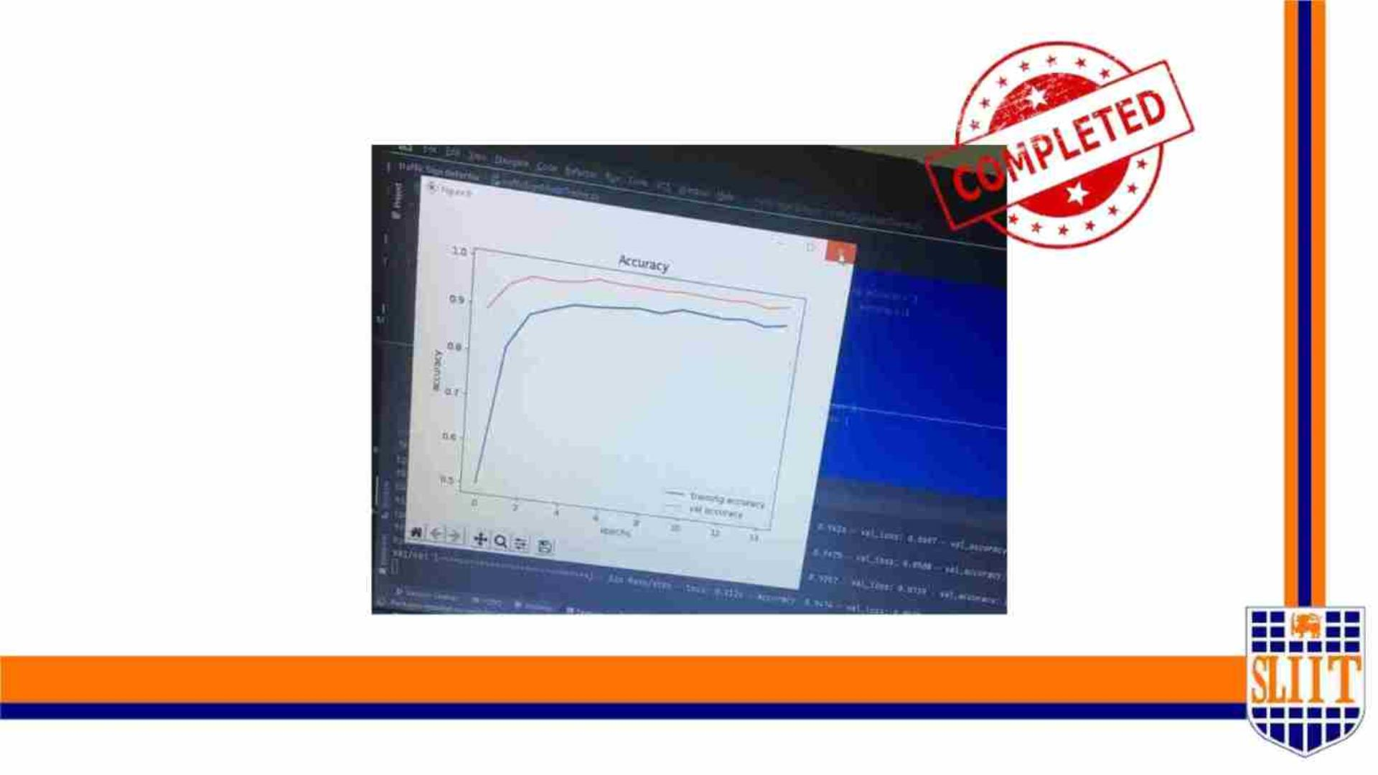
D. Model Accuracy of Traffic sign detection
model
SMART NAVIGATION TOOL FOR VISUALLY IMPAIRED PEOPLE
50
IT19008424 | Weragoda W.R.J.M.| 2022-227
47

Slide 48
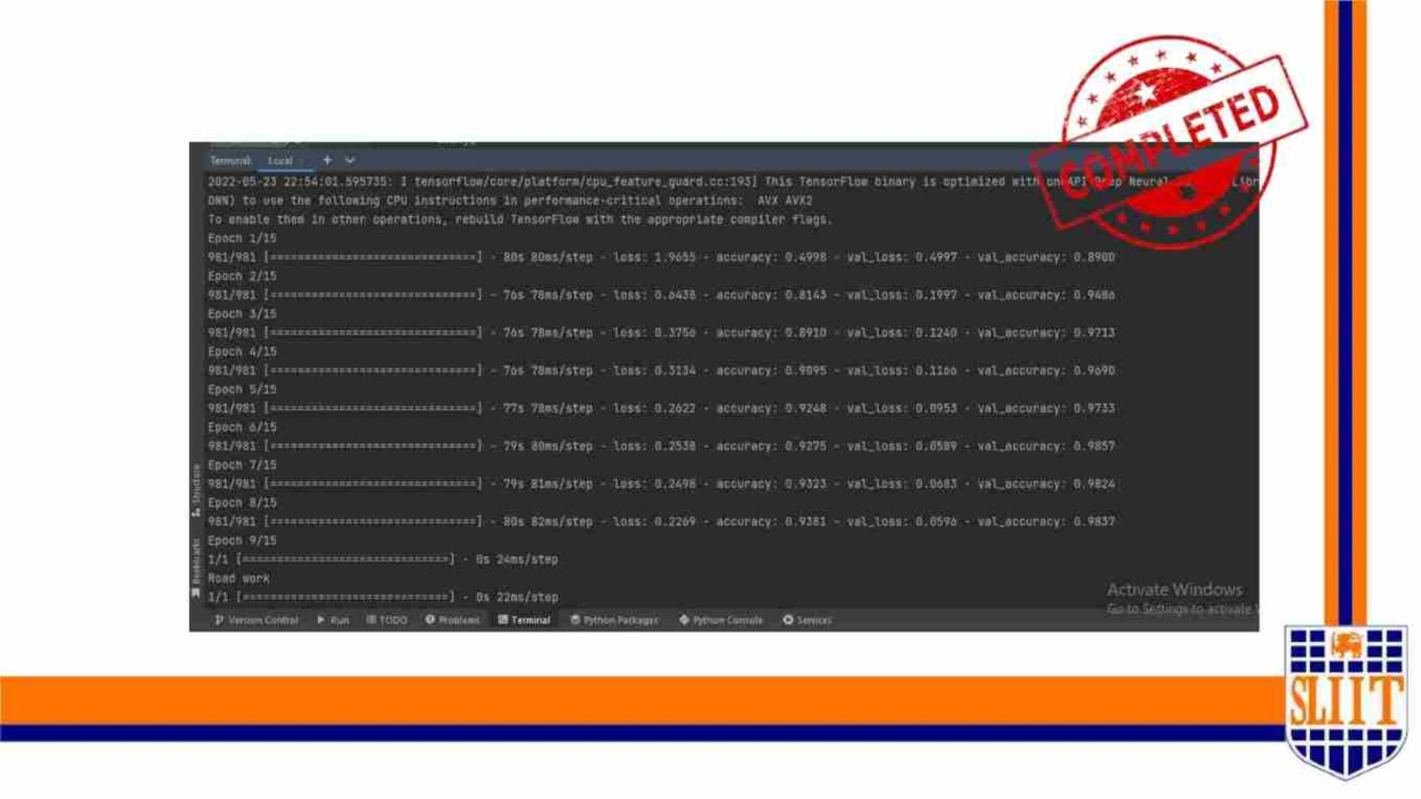
Model Accuracy
SMART NAVIGATION TOOL FOR VISUALLY IMPAIRED PEOPLE
51
IT19008424 | Weragoda W.R.J.M.| 2022-227
48

Slide 49
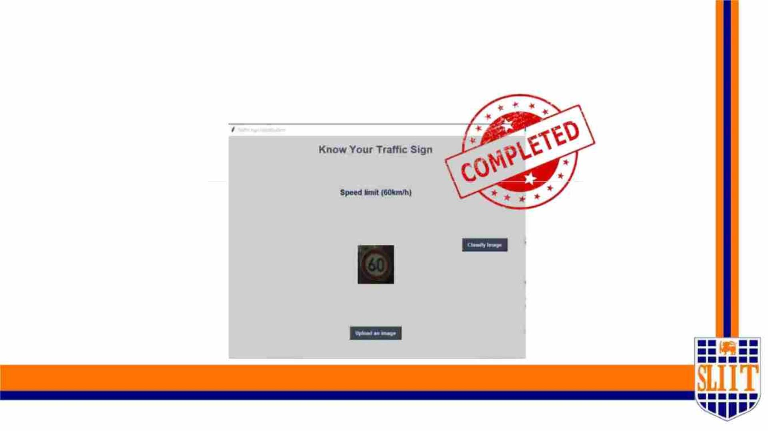
E. Output of Model
SMART NAVIGATION TOOL FOR VISUALLY IMPAIRED PEOPLE
52
IT19008424 | Weragoda W.R.J.M.| 2022-227
49

Slide 50
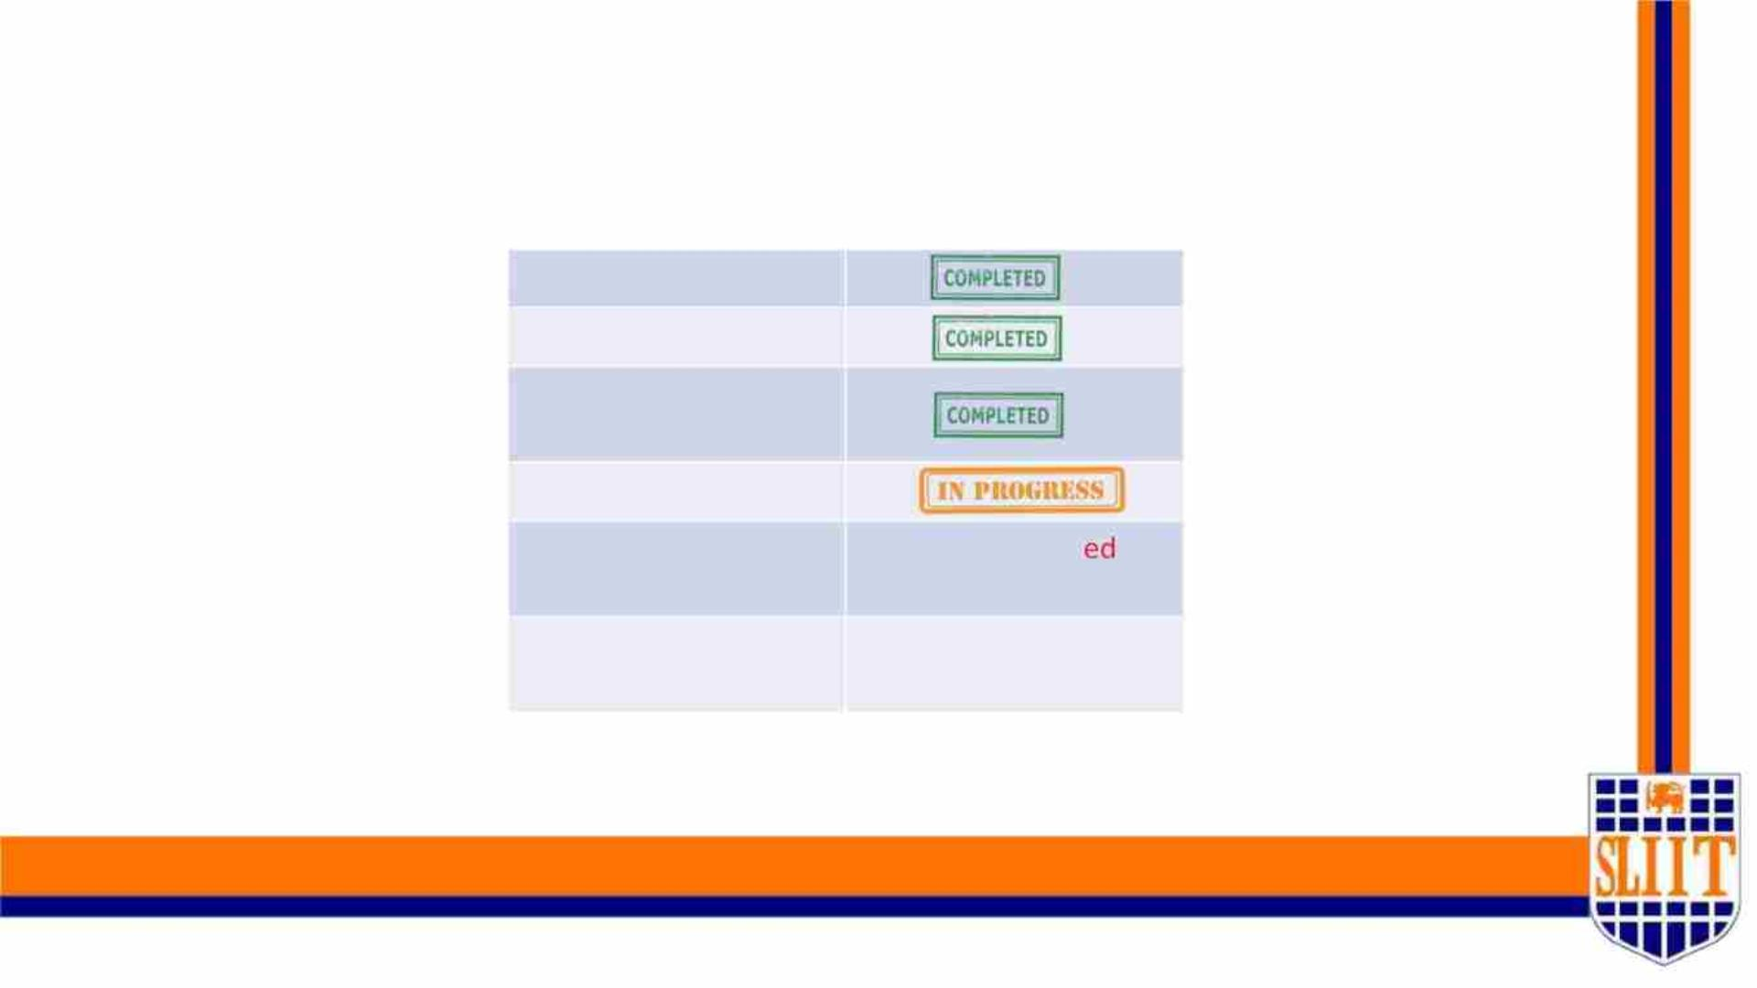
E. Output of Model
Dataset preparing
Train and test model
Test phase 1(check
accuracy )
Improve the accuracy
Implement vocal
command
Not Complet
Fail
User Testing
SMART NAVIGATION TOOL FOR VISUALLY IMPAIRED PEOPLE
52
IT19008424 | Weragoda W.R.J.M.| 2022-227
50

Slide 51
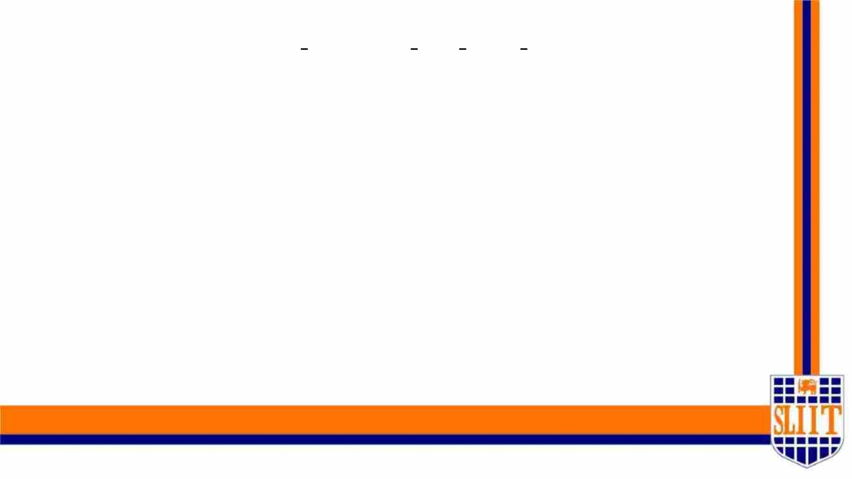
Alternative System for APS System
• This IOT part requires two Raspberry Pi modules.
• One is in our main model and the other one should be connected to the
countdown pedestrian signals.
• Those two will be connected via Wi-Fi when user reaches the traffic signals.
• Then it will notify the user about remaining time and decision of crossing the
road or wait for the next turn via headphones.
• Due to the current situation of the country we couldn’t find pi modules.
• I’ m hoping to integrate that part using two lap tops for the 100% evaluation.
SMART NAVIGATION TOOL FOR VISUALLY IMPAIRED PEOPLE
46
IT19008424 | Weragoda W.R.J.M.| 2022-227

Slide 52
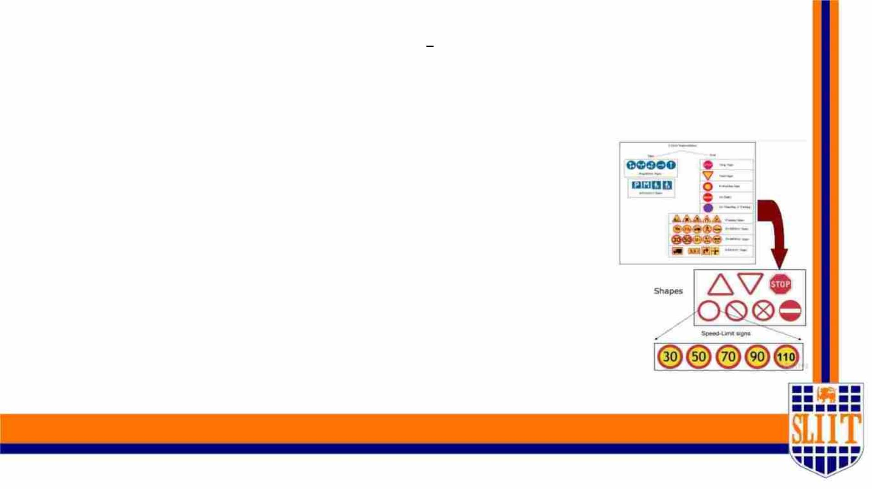
FUTURE WORKS
• We are hoping to use raspberry pi4
module for the future implementation
of the component.
• Tune the model to those data
samples and get higher results.
• Integrating all the four component
to a single unit.
SMART NAVIGATION TOOL FOR VISUALLY IMPAIRED PEOPLE
46
IT19008424 | Weragoda W.R.J.M.| 2022-227

Slide 53
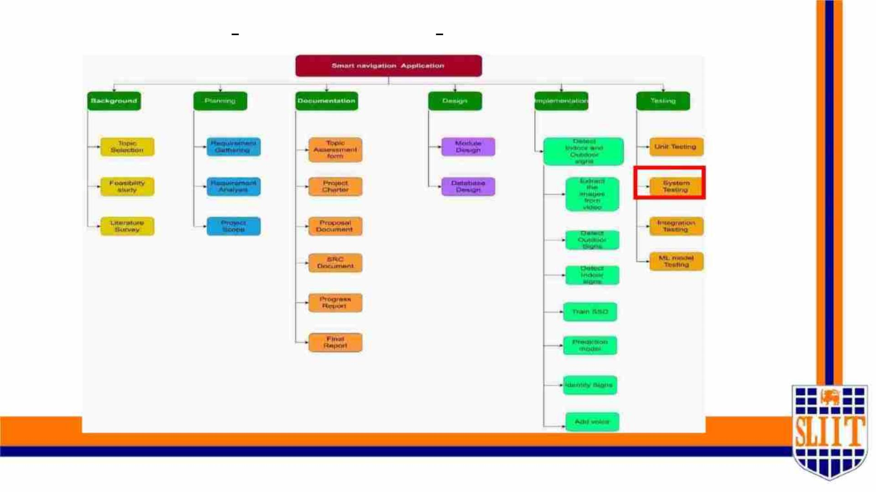
WORK BREAKDOWN STRUCTURE
SMART NEVIGATION TOOL FOR VISUALLY IMPAIRED PEOPLE
55
IT19008424 | Weragoda W.R.J.M.| 2022-227
53

Slide 54
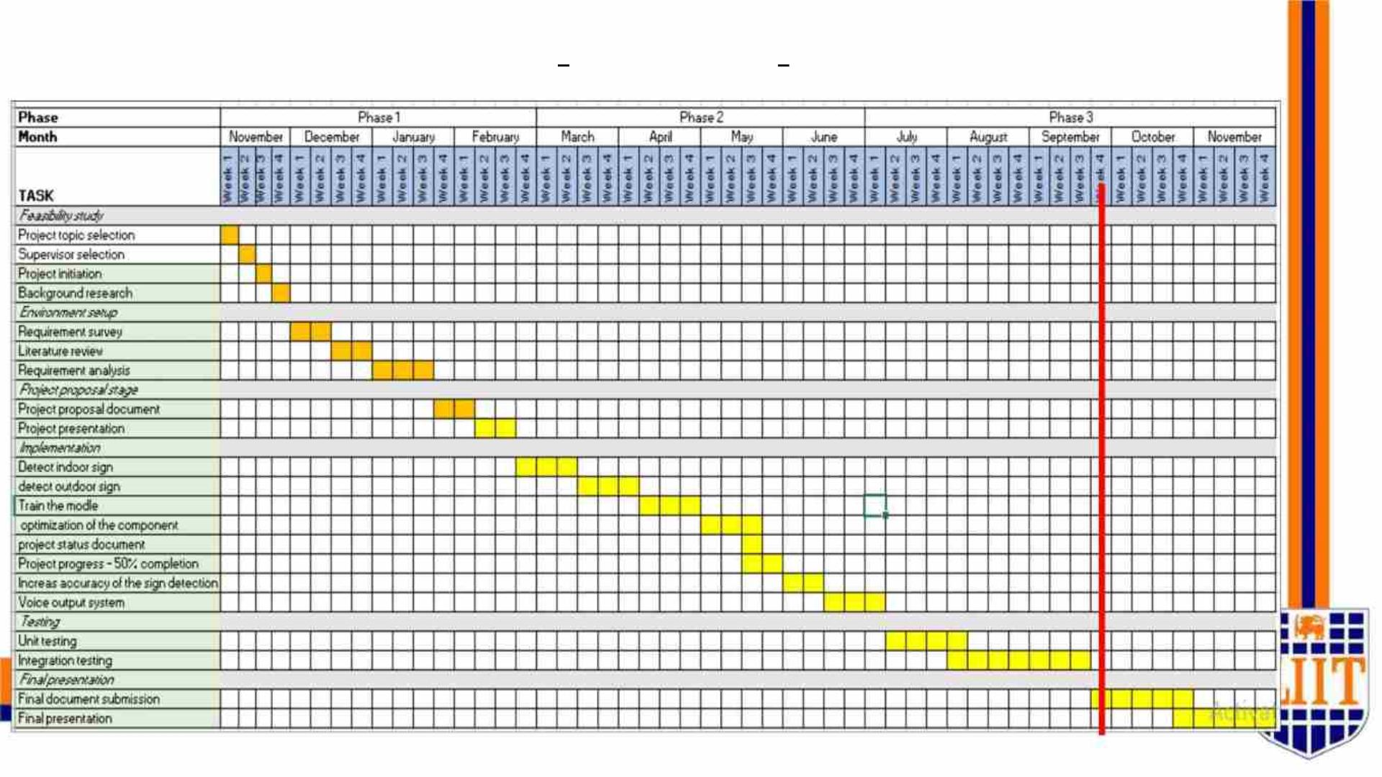
GANTT PROCESS CHART
57
IT19008424 | Weragoda W.R.J.M.| 2022-227
54

Slide 55
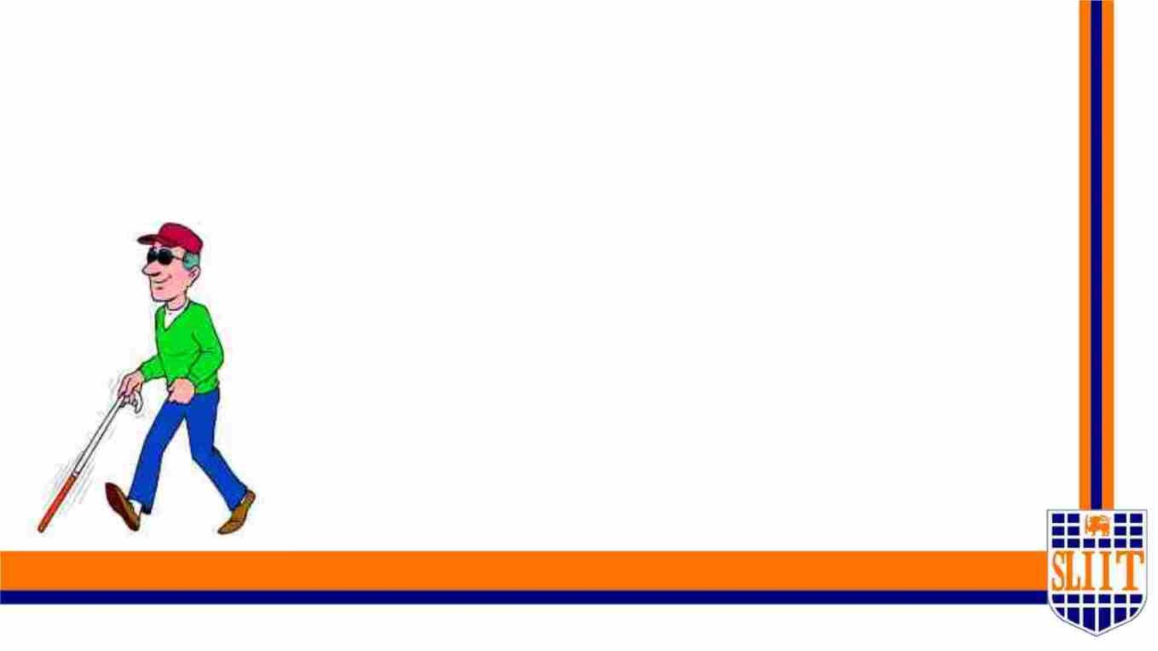
REFERENCES
SMART NAVIGATION TOOL FOR VISUALLY IMPAIRED PEOPLE
58
IT19008424 | Weragoda W.R.J.M.| 2022-227
55

Slide 56

• [1] Object recognition for blind people based on features extraction.
• [2] Object Detection and Identification for Blind People in Video Scene
• [3] Blind Navigation System Using Image Processing and Embedded System
• [4] World Health Organization, Webpage:http://www.who.int//mipfiles/2400/AllenFoster.pdf
• [5] F. Wong, R. Nagarajan, S. Yaacob and A. Chekima, “Electronic travel aids for visually impaired – A guided tour”, Proceedings of
Conference in Engineering in Sarawak, 2000, pp. 377-382.
• [6] L. Kay, “An Ultrasonic sensing probe as a mobility aid for the blind”, Ultrasonics 1964, 2: 53-59.
• [7] N. Pressey, “Mowat Sensor”, Focus 3, 1977, pp. 35-39
• [8] P. Meijer, “An Experimental System for Auditory Image Representations,” IEEE Transactions on Biomedical Engineering, vol. 39, no 2, pp.
112-121, Feb 1991.
• [9] G. Sainarayanan, “On Intelligent Image Processing Methodologies Applied to Navigation Assistance for Visually Impaired”, Ph. D. Thesis,
University Malaysia Sabah, 2002.
• [10] . Balakrishnan, G. Sainarayanan, R. Nagarajan and S. Yaacob, “Wearable Real-Time Stereo Vision for the Visually Impaired,”
Engineering Letters, vol. 14, no. 2, 2007.
• [11] G. P. Fajarnes, L. Dunai, V. S. Praderas and I. Dunai, “CASBLiP- a new cognitive object detection and orientation system for impaired
people,” Proceedings of the 4th International Conference on Cognitive Systems, ETH Zurich, Switzerland, 2010.
SMART NAVIGATION TOOL FOR VISUALLY IMPAIRED PEOPLE
59
IT19008424 | Weragoda W.R.J.M.| 2022-227
56

Slide 57
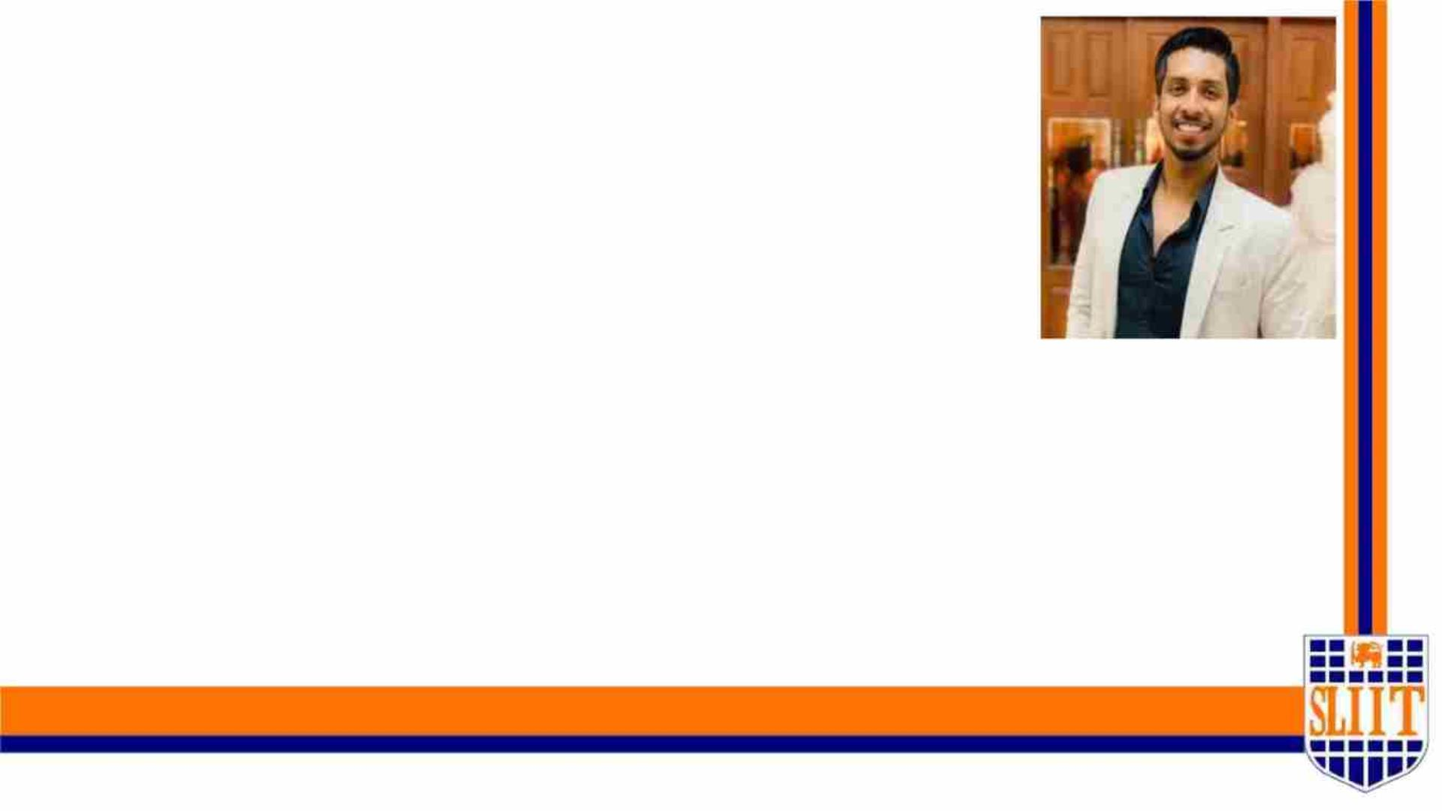
IT19042152 | MADUSHAN W. A.
SPECIALIZATION : SE
SMART NAVIGATION TOOL FOR VISUALLY IMPAIRED PEOPLE
60
IT19042152 | W A Madushan | 2022-227
57

Slide 58
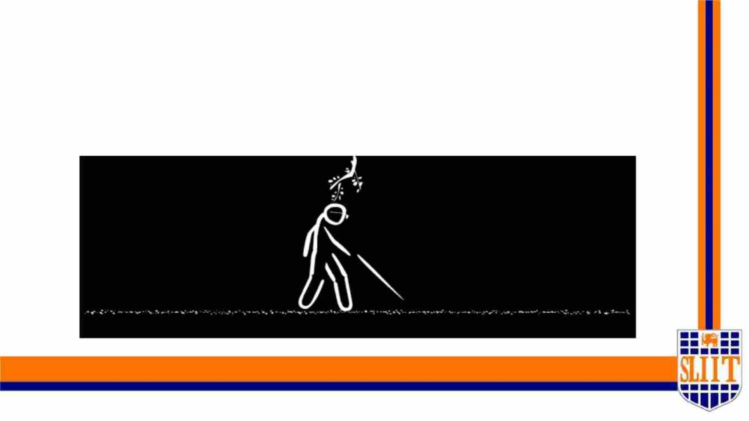
OBSTACLE DETECTION FOR SAFE
NAVIGATION
SMART NAVIGATION TOOL FOR VISUALLY IMPAIRED PEOPLE
61
IT19042152 | W A Madushan | 2022-227
58

Slide 59

RESEARCH PROBLEM
• The main problem with this device is that users must be trained in its use for
more than 100 hours – a substantial “hidden” cost.
• In addition, the white cane requires the user to actively scan the small area
ahead of them. They have to touch everything using the cane to get an idea
about them.
• Detecting potholes using a cane also not a convenient task.
SMART NAVIGATION TOOL FOR VISUALLY IMPAIRED PEOPLE
62
IT19042152 | W A Madushan | 2022-227
59

Slide 60

MAIN OBJECTIVE
Recognize obstacles ,walking surface and pothole using the camera and
smart cane to provide appropriate information through audio and
signal for safe navigation.
SMART NAVIGATION TOOL FOR VISUALLY IMPAIRED PEOPLE
64
IT19042152 | W A Madushan | 2022-227
60

Slide 61
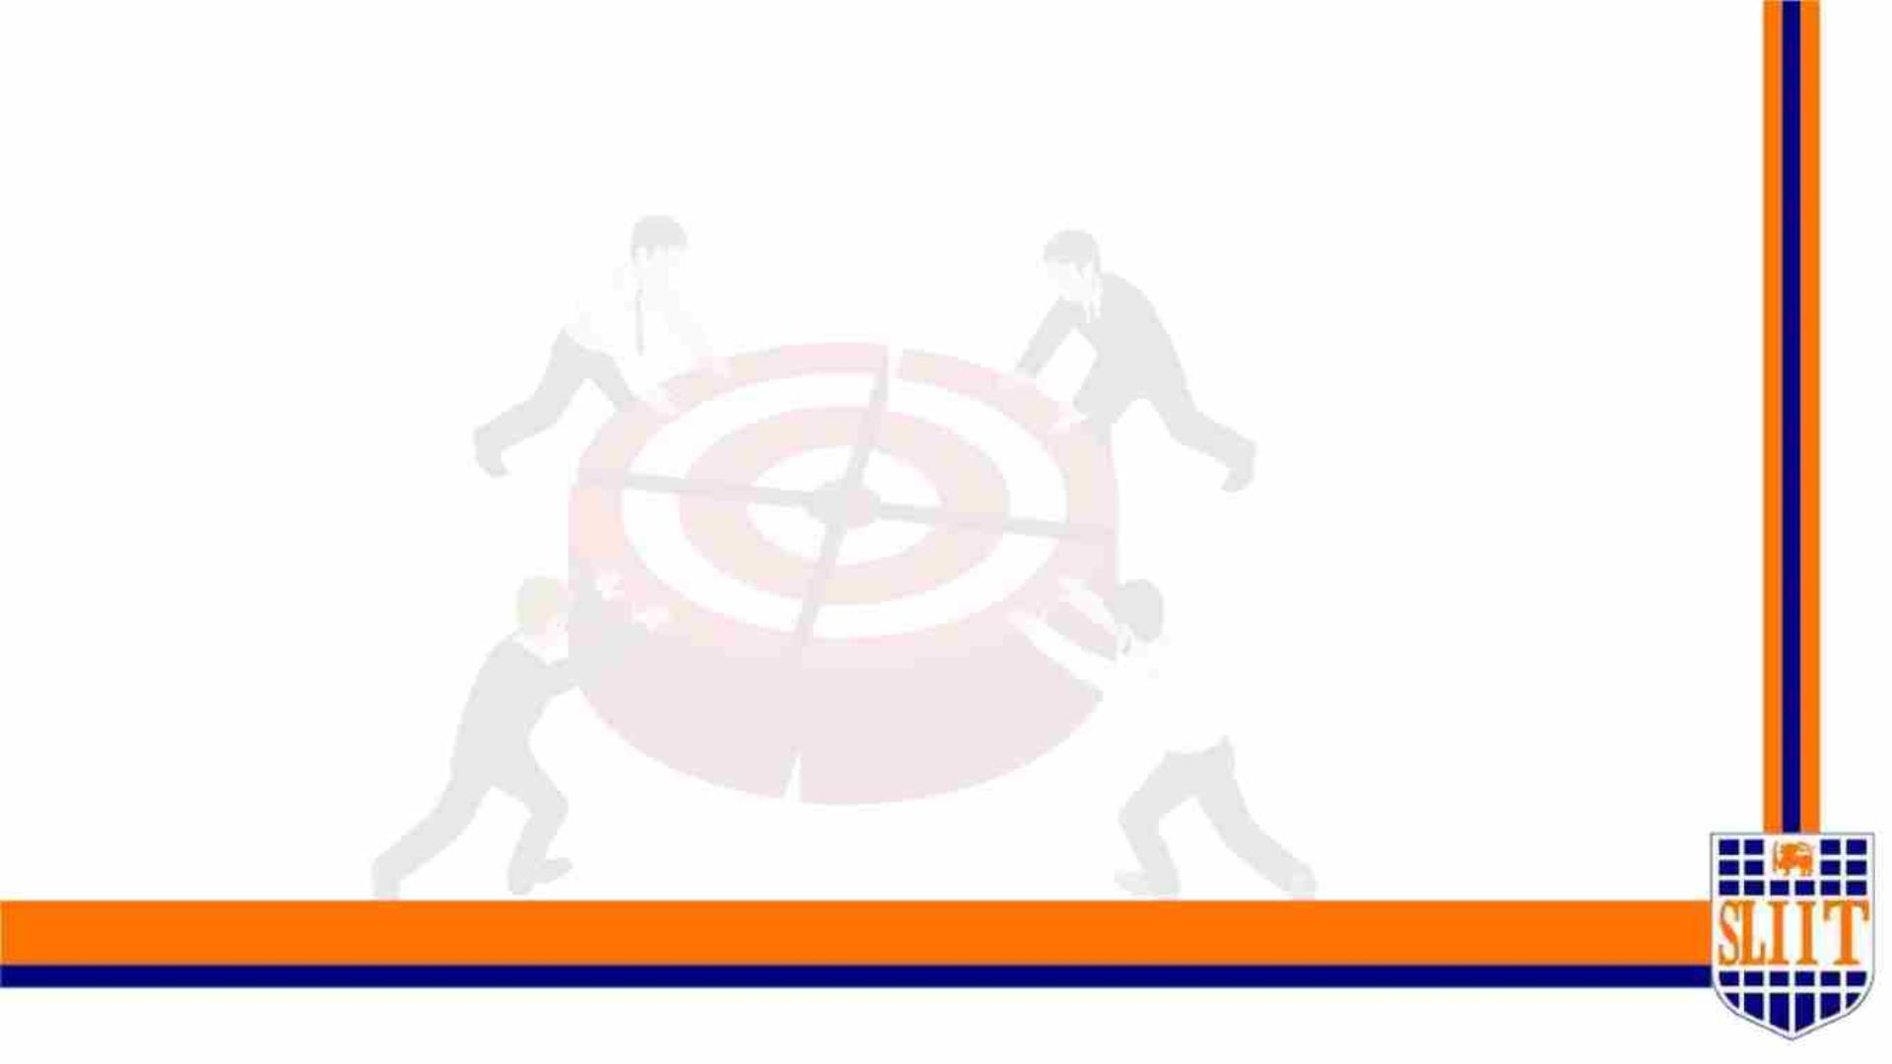
MAIN OBJECTIVE & SPECIFIC OBJECTIVES
•Detect obstacles in user path – Smart Cane plugin.
•Detect walking surface – Smart Glass.
•Design and train a models to identify pothole according to inputs.
•Design and train a models to identify surface behavior according to inputs.
•Design a smart cane to identify the obstacles(IOT part).
•Impalement a vocal instruction system.
SMART NAVIGATION TOOL FOR VISUALLY IMPAIRED PEOPLE
65
IT19042152 | W A Madushan | 2022-227
61

Slide 62

RESEARCH METHODOLOGY
SMART NAVIGATION TOOL FOR VISUALLY IMPAIRED PEOPLE
66
IT19042152 | W A Madushan | 2022-227
62

Slide 63
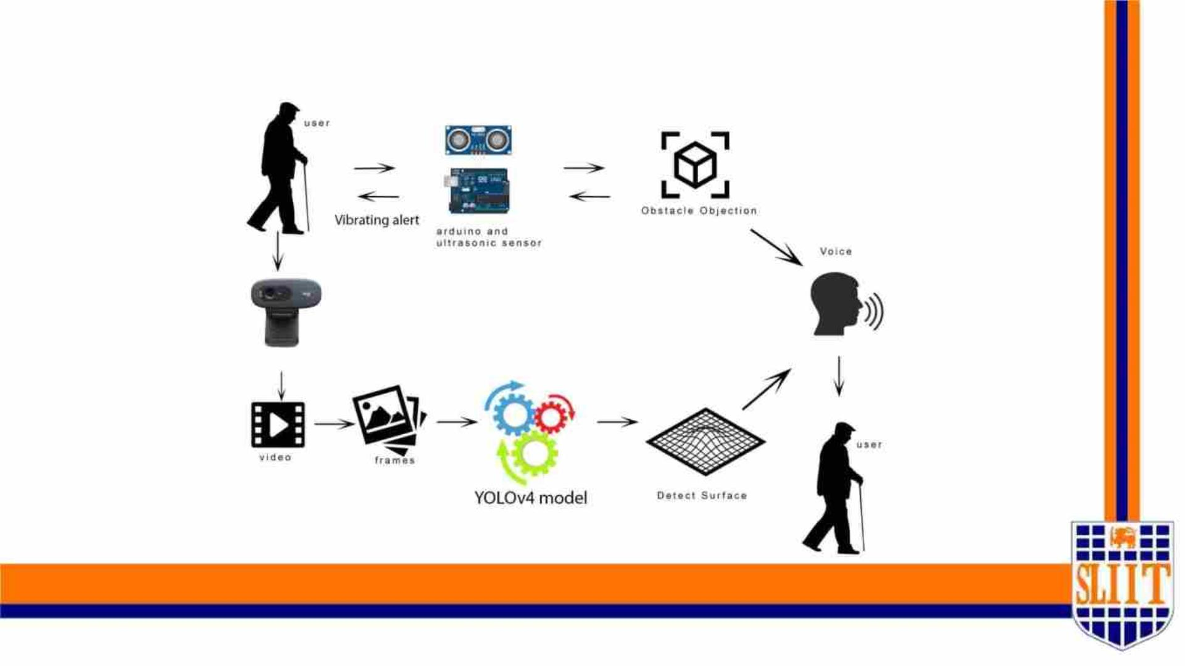
System Diagram
SMART NAVIGATION TOOL FOR VISUALLY IMPAIRED PEOPLE
67
IT19042152 | W A Madushan | 2022-227
63

Slide 64
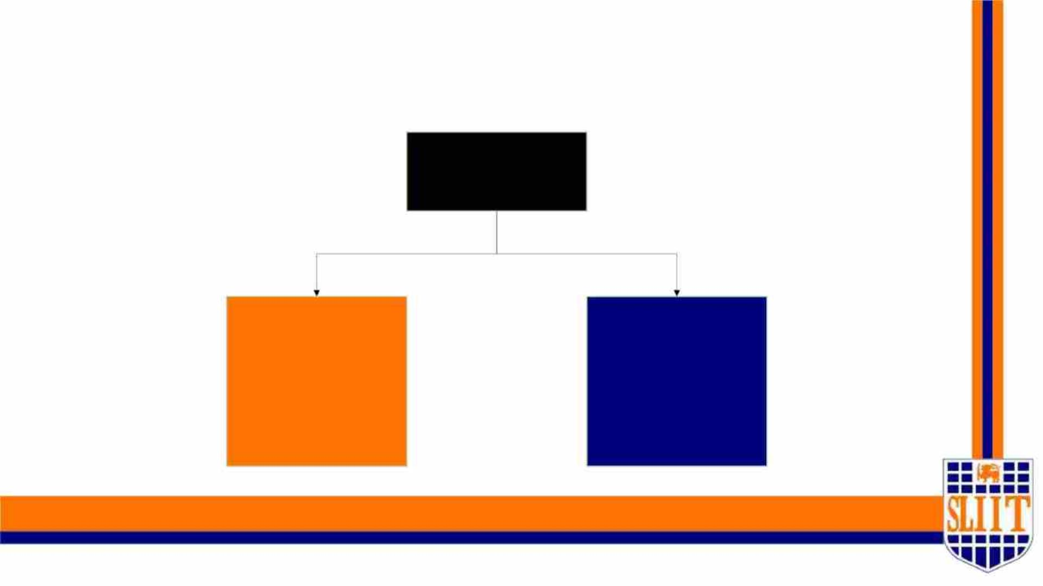
METHODOLOGY
Component
Pothole Detection
and Surface
Detection
Smart cane (detect
obstacles)
SMART NAVIGATION TOOL FOR VISUALLY IMPAIRED PEOPLE
68
IT19042152 | W A Madushan | 2022-227
64

Slide 65
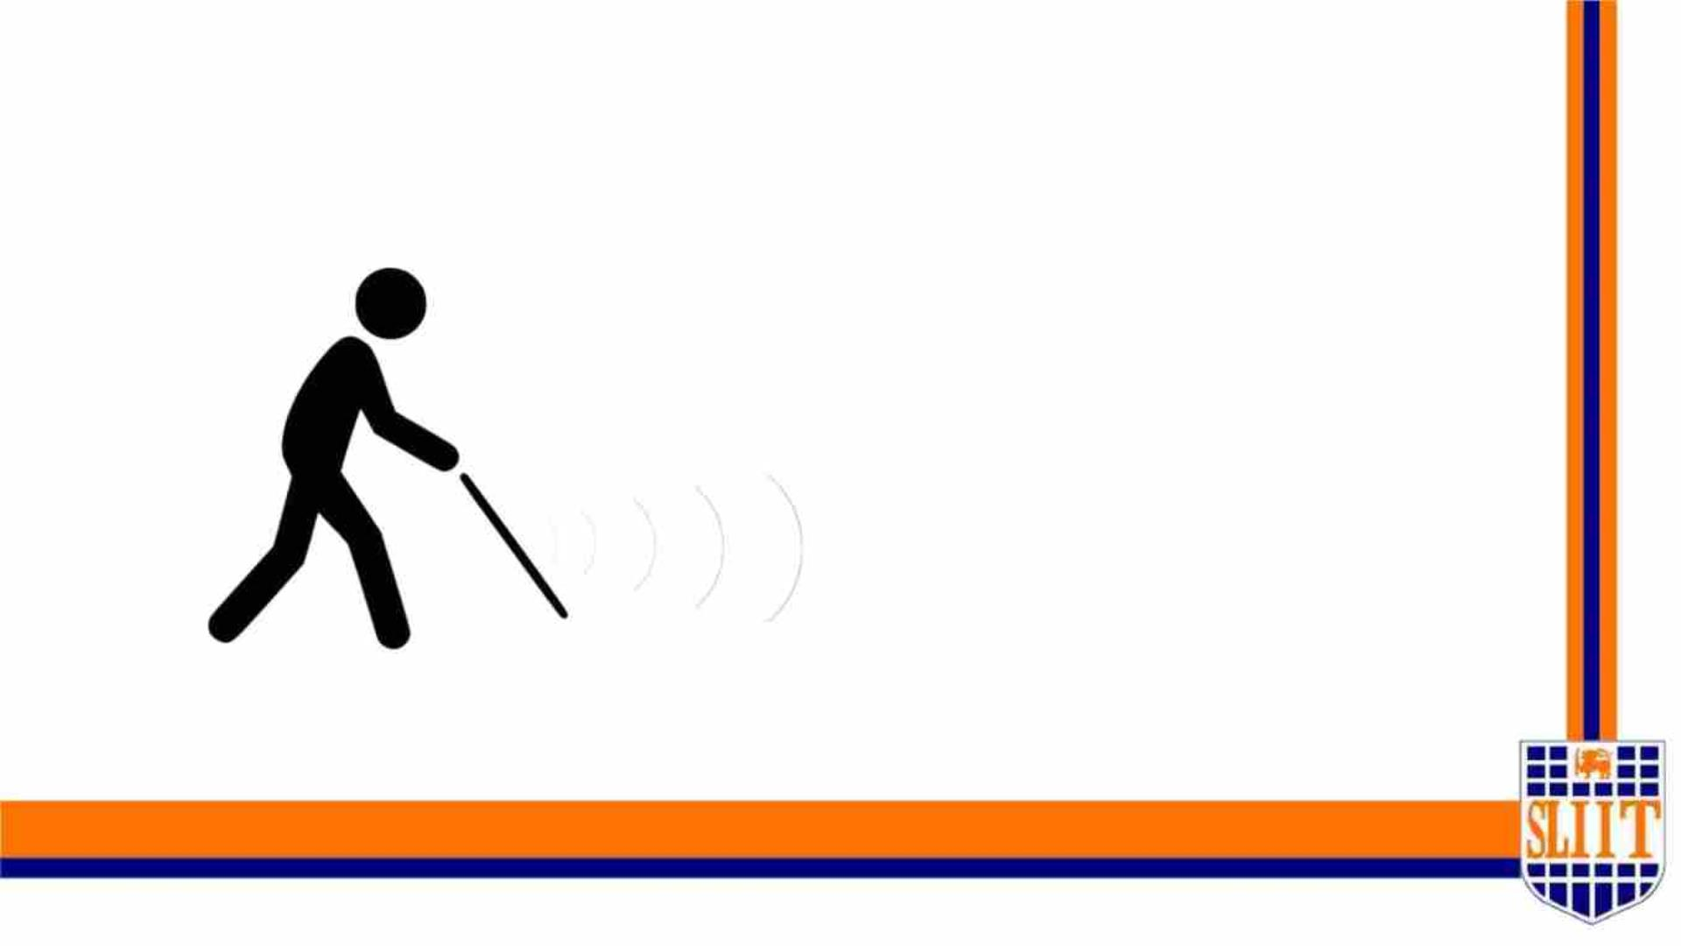
SMART CANE
SMART NAVIGATION TOOL FOR VISUALLY IMPAIRED PEOPLE
69
IT19042152 | W A Madushan | 2022-227
65

Slide 66
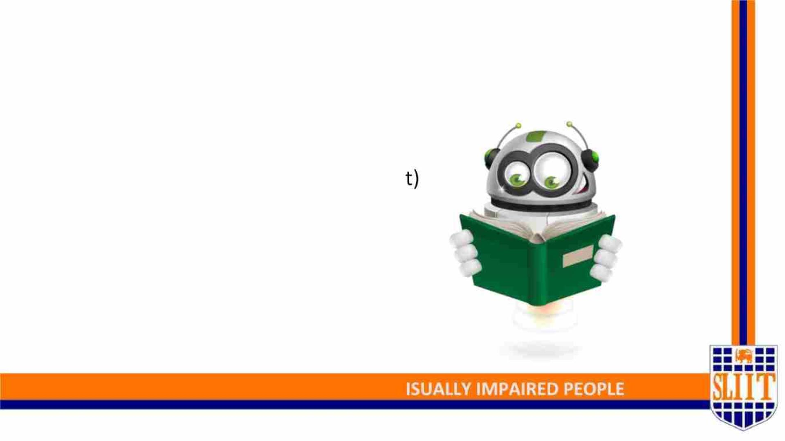
Features of smart cane plugin
• 2m obstacle detection coverage
• Fast response time (Vibration Aler
• Automatic lighting system
SMART NAVIGATION TOOL FOR V
71
IT19042152 | W A Madushan | 2022-227
66

Slide 67
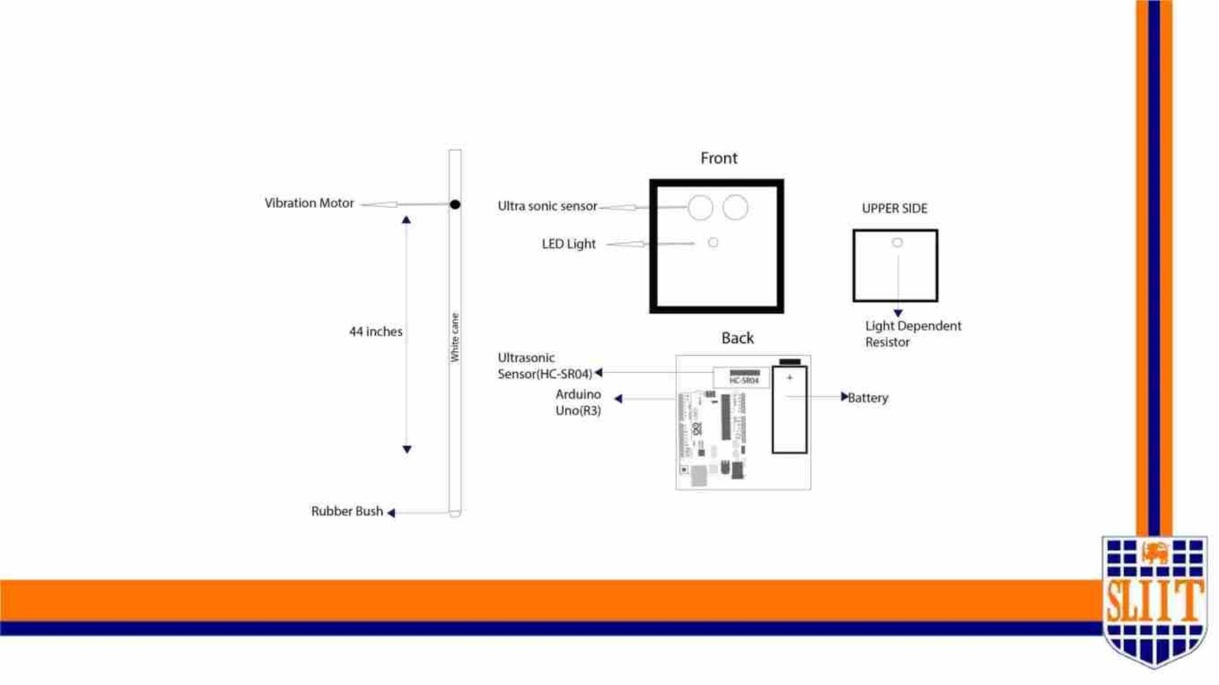
Final Blueprint of smart cane plugin
SMART NAVIGATION TOOL FOR VISUALLY IMPAIRED PEOPLE
67
IT19042152 | W A Madushan | 2022-227
67

Slide 68

Final Output
SMART NAVIGATION TOOL FOR VISUALLY IMPAIRED PEOPLE
69
IT19042152 | W A Madushan | 2022-227
68

Slide 69

Completion of Smart cane plugin – 100%
Draw the blueprint of the plugin
Draw the prototype
Implement Arduino code and ultrasonic sensor
Implement the buzzer
Testing phase 01
Demo assembling
Testing phase 02
Implement LDR sensor and lighting system
Final assembling
Testing phase 03
User Testing
Final release
SMART NAVIGATION TOOL FOR VISUALLY IMPAIRED PEOPLE
74
IT19042152 | W A Madushan | 2022-227
69

Slide 70

Surface Detection & Pothole
Detectio
SMART NAVIGATION TOOL FOR VISUALLY IMPAIRED PEOPLE
75
IT19042152 | W A Madushan | 2022-227
70

Slide 71

Methodology Major phases
A. Data preparation
B. Train model on data
C. Analysis/Evolution Model
D. Detect pothole and surface from inputs
E. Voice command implementation
SMART NAVIGATION TOOL FOR VISUALLY IMPAIRED PEOPLE
76
IT19042152 | W A Madushan | 2022-227
71

Slide 72

B. Train And Testing Model On Data
SMART NAVIGATION TOOL FOR VISUALLY IMPAIRED PEOPLE
79
IT19042152 | W A Madushan | 2022-227
72

Slide 73

C. Accuracy of Pothole detection model
Training Accuracy :- 98.41% and Testing Accuracy :- 81.25%
SMART NAVIGATION TOOL FOR VISUALLY IMPAIRED PEOPLE
80
IT19042152 | W A Madushan | 2022-227
73

Slide 74

C. Output of Model
SMART NAVIGATION TOOL FOR VISUALLY IMPAIRED PEOPLE
81
IT19042152 | W A Madushan | 2022-227
74

Slide 75

A. Data preparation
SMART NAVIGATION TOOL FOR VISUALLY IMPAIRED PEOPLE
77
IT19042152 | W A Madushan | 2022-227
75

Slide 76

Completion of surface and pothole detection - 70%
Pothole detection
Dataset preparing
Surface detection
Dataset preparing
Train and test model
Train and test model
Test phase 1(check
accuracy )
Test phase 1(check
accuracy )
Fail
Improve the accuracy
Improve the accuracy
Not Completed
Not Completed
Not Completed
Implement vocal
command
Not Compl d
Fail
Implement vocal
command
User Testing
User Testing
SMART NAVIGATION TOOL FOR VISUALLY IMPAIRED PEOPLE
83
IT19042152 | W A Madushan | 2022-227
76

Slide 77

Final Solution
SMART NAVIGATION TOOL FOR VISUALLY IMPAIRED PEOPLE
75
IT19042152 | W A Madushan | 2022-227
77

Slide 78

IT19049878| Jathusanan .E
SPECIALIZATION : SE
SMART NAVIGATION TOOL FOR VISUALLY IMPAIRED PEOPLE
90
IT19049878 | Jathusanan.E | 2022-277
78

Slide 79

INTRODUCTION
Why do we need this
system ?
What is this system ?
Whom will get benefit ?
It will smartly guide through
the walking-lanes on the
Main roads
A Walking-lane Navigation
System
Visually Impaired People
SMART NAVIGATION TOOL FOR VISUALLY IMPAIRED PEOPLE
91
IT19049878 | Jathusanan.E | 2022-277
79

Slide 80

Research Gap
Ø Navigating through the walk-lanes
Ø Voice alerts
Ø People Alert
SMART NAVIGATION TOOL FOR VISUALLY IMPAIRED PEOPLE
94
IT19049878 | Jathusanan.E | 2022-277
80

Slide 81

Specific and Sub Objectives
• Specific Objective
Provide a smart way for visually impaired people to navigate through the walk-lanes.
• Sub Objectives
§ Develop an alogorithm to detect walk-lanes.
§ Build a Model to detect the people on the walk-lanes.
§ Provide a proper navigation within the walk-lanes.
§ Provide proper alert messages to the user.
SMART NAVIGATION TOOL FOR VISUALLY IMPAIRED PEOPLE
93
IT19049878 | Jathusanan.E | 2022-277
81

Slide 82

Technologies
• Open CV – Computer Vision Python Library
• YOLO - is a state-of-the-art, real-time object detection system.
• Pycharm – IDE for python
SMART NAVIGATION TOOL FOR VISUALLY IMPAIRED PEOPLE
94
IT19049878 | Jathusanan.E | 2022-277

Slide 83

Requirements
Non - Functional
Requirements
Functional
Requirements
v Accuracy
v Speed
v Portability
v Compatibility
v Usability
v Reliability
v Scalability
v Walk-lane Detection
v Prompt proper alert
messages
v Guide safely through the
Walk-lanes
SMART NAVIGATION TOOL FOR VISUALLY IMPAIRED PEOPLE
94
IT19049878 | Jathusanan.E | 2022-277
83

Slide 84

Completion of the project
Completed work
Work to be completed
ü Walk-Lane Detection
o Voice alert generation
ü Getting alert messages in the
text format.
o Integrate with the hardware
component
ü Build model to detect the
people on the walk-lanes
SMART NAVIGATION TOOL FOR VISUALLY IMPAIRED PEOPLE
95
IT19049878 | Jathusanan.E | 2022-277

Slide 85

Evidence
SMART NAVIGATION TOOL FOR VISUALLY IMPAIRED PEOPLE
95
IT19049878 | Jathusanan.E | 2022-277
85

Slide 86

Evidence
SMART NAVIGATION TOOL FOR VISUALLY IMPAIRED PEOPLE
95
IT19049878 | Jathusanan.E | 2022-277
86

Slide 87

Work Breakdown Structure
SMART NAVIGATION TOOL FOR VISUALLY IMPAIRED PEOPLE
95
IT19049878 | Jathusanan.E | 2022-277
87

Slide 88

Gantt Chart
SMART NAVIGATION TOOL FOR VISUALLY IMPAIRED PEOPLE
95
IT19049878 | Jathusanan.E | 2022-277
88

Slide 89
References
[1] A.J. Jackson, J.S. Wolffsohn, "Low Vision Manual", Elsevier, Philadelphia, USA (2007).
[2] L.E.F. Simpson R.C., R.A. Cooper, "J. Rehabil. Res. Dev., 45 (1) (2008), pp. 53-72.
[3] I. Ulrich, J. Borenstein "The GuideCane – applying mobile robot technologies to assist the visually impaired" IEEE
Trans. Syst. Man Cybern. Part A: Syst. Hum., 31 (2) (2001), pp. 131-136.
[4] S. Shoval, J. Borenstein, Y. Koren "Auditory guidance with the Navbelt – a computerized travel aid for the blind"
IEEE Trans. Syst. Man Cybern. Part C: Appl. Rev., 28 (3) (1998), pp. 459-467.
[5] P. Dollar, C. Wojek, B. Schiele, P. Perona "Pedestrian detection: an evaluation of the state of the art" IEEE Trans.
Pattern Anal. Mach. Intell., 34 (4) (2012), pp. 743-761.
[6] S. Se, M. Brady "Road feature detection and estimation" Mach. Vis. Appl., 14 (3) (2003), pp. 157-165.
[7] M.S. Uddin, T. Shioyama "Bipolarity and projective invariant-based zebra-crossing detection for the visually
impaired" Proceedings of IEEE Computer Society Conference on Computer Vision and Pattern Recognition
Workshops (2005), pp. 22-30 .
SMART NAVIGATION TOOL FOR VISUALLY IMPAIRED PEOPLE
96
IT19049878 | Jathusanan.E | 2022-277
89

Slide 90

Future Scope
Increase the Portability of the device
Adding Extra functionalities to the system.
Increase the dataset and accuracy
SMART NAVIGATION TOOL FOR VISUALLY IMPAIRED PEOPLE
97
90

Slide 91

Ability of Commercialization
• Identifying the target audiences.
• Create social media and flyer marketing plan in SLIIT.
• Advertise on course web and other social medias.
• Develop a pricing strategy after a year of product release.
• Send e-mail to SLIIT students about the application.
SMART NAVIGATION TOOL FOR VISUALLY IMPAIRED PEOPLE
97
91

Slide 92

SMART NAVIGATION TOOL FOR VISUALLY IMPAIRED PEOPLE
98
92

